Slide 1

BarnOwl
FULLY INTEGRATED RISK MANAGEMENT, COMPLIANCE AND AUDIT
SOFTWARE
BarnOwl spotlight on Key Indicators (KIs)
25 July 2024
Presented by Jonathan Crisp

Slide 2
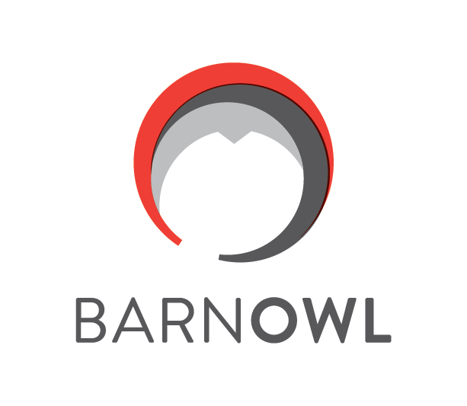
Agenda – Spotlight on Key Indicators
Overview of BarnOwl v11
Benefits of Key Indicators
Key Indicator enhancements in BarnOwl v11
Step by step demo of Key indicators
How do I upgrade to BarnOwl v11
Conclusion

Slide 3
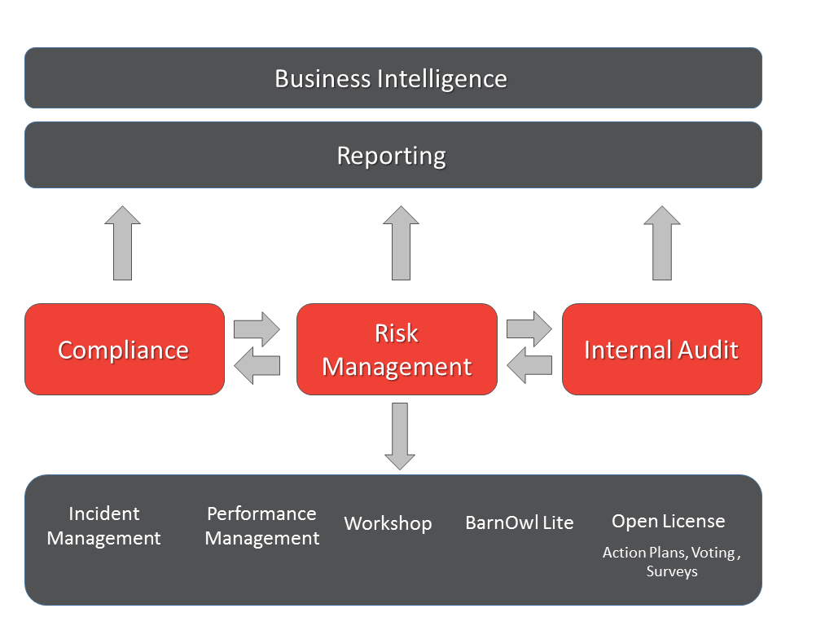
Introduction - BarnOwl integrated modules

Slide 4
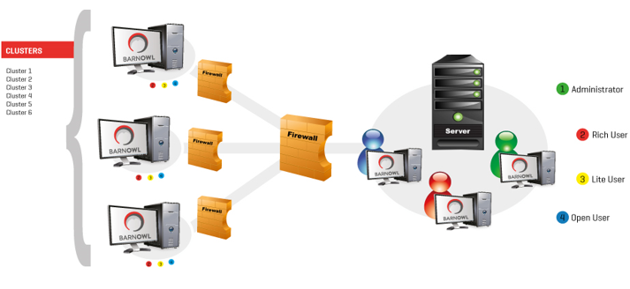
Types of user and BarnOwl user interface (UI)
Admin User (Risk, Compliance and Audit): SMC remains in the Desktop app (rich). Setup of processes, org structure, votes, import compliance acts remain in the BarnOwl Desktop app.
Risk champion: will use BarnOwl Web (no longer called BarnOwl Lite)
Compliance champion: will continue to use the BarnOwl Desktop app and BarnOwl Web
Audit user: will continue to use the BarnOwl Desktop app
Open license user: will use the BarnOwl Web open license to respond to: Action Plans, Voting (RSA, CSA), Surveys, Questionnaires, Key Indicator inputs

Slide 5
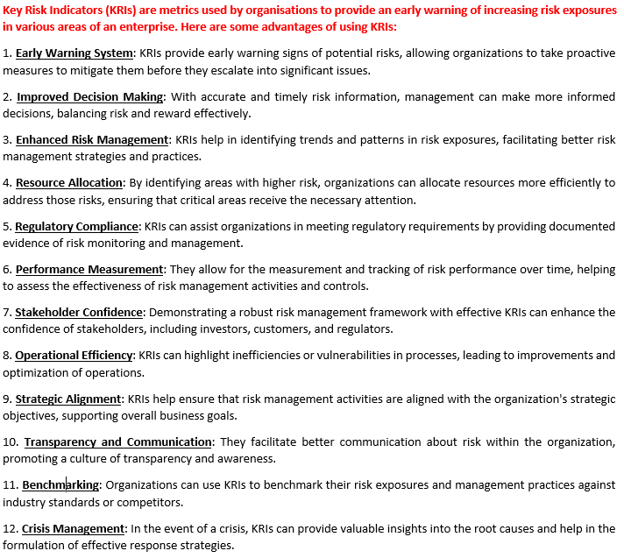
Key Indicators – bringing risk management to life
Source: ChatGPT

Slide 6
Key Indicator enhancements in BarnOwl v11
  Configuring a financial period: For example 1 April 2024 to 31 March 2025 aligns KI reporting with your financial year
  Closing off KI periods: simple and effective way to prevent KI values being changed in previous periods
  Capturing of KI values by Owners: simplified interface for capturing KI values in BarnOwl’s free web-portal (intranet)
  Re-assessment triggers: Automatic re-assessments triggers when a KI threshold is breached (Objectives, Risks and Controls)
  Extensive reporting: built-in KI report as well as Power BI dashboards (drill down, trends etc)

Slide 7
Key Indicator demo
Step 1: Once-off configuration of Financial Periods (Administrator)
Step 2: Create and configure a Key Indicator (Administrator)
Step 3: Capture Key Indicator values (KI Owner)
Step 4: Risk re-assessment (Risk Owner)
Step 5: Key Indicator monitoring and reporting (Management / Risk Officer)
Step 6: Close a Key Indicator period (Administrator)

Slide 8
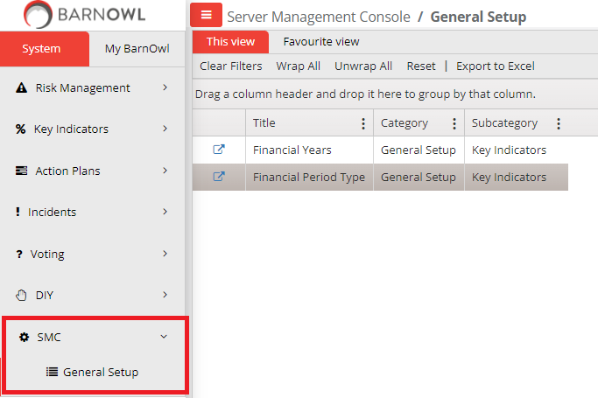
Step 1: Once-off configuration of Financial Periods (Administrator)

Slide 9
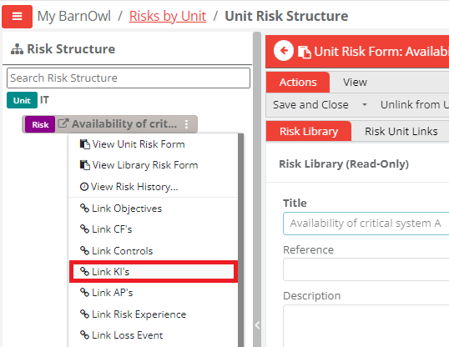
Step 2.1: Create and link a Key Indicator

Slide 10
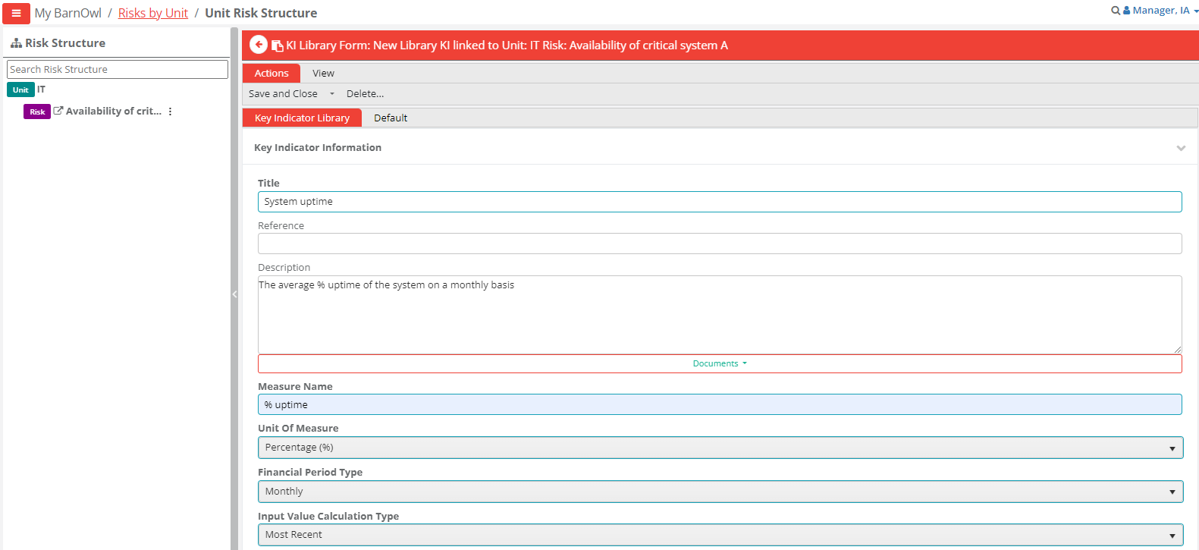
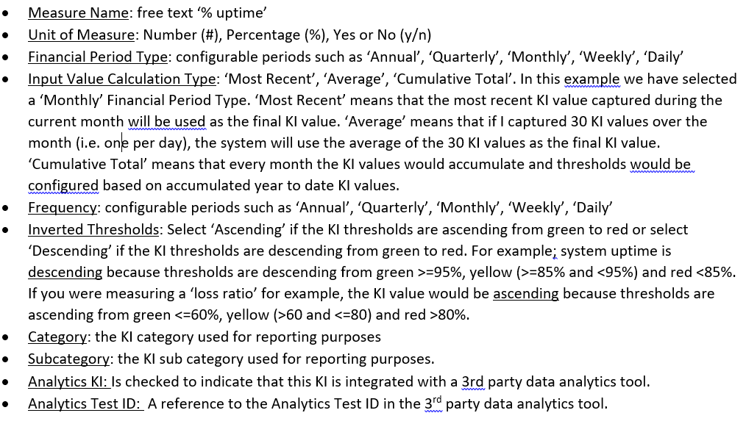
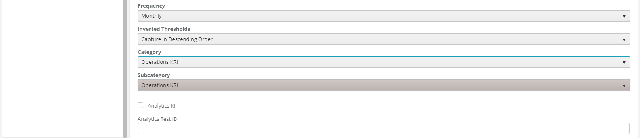
Step 2.2: Configure the Key Indicator

Slide 11
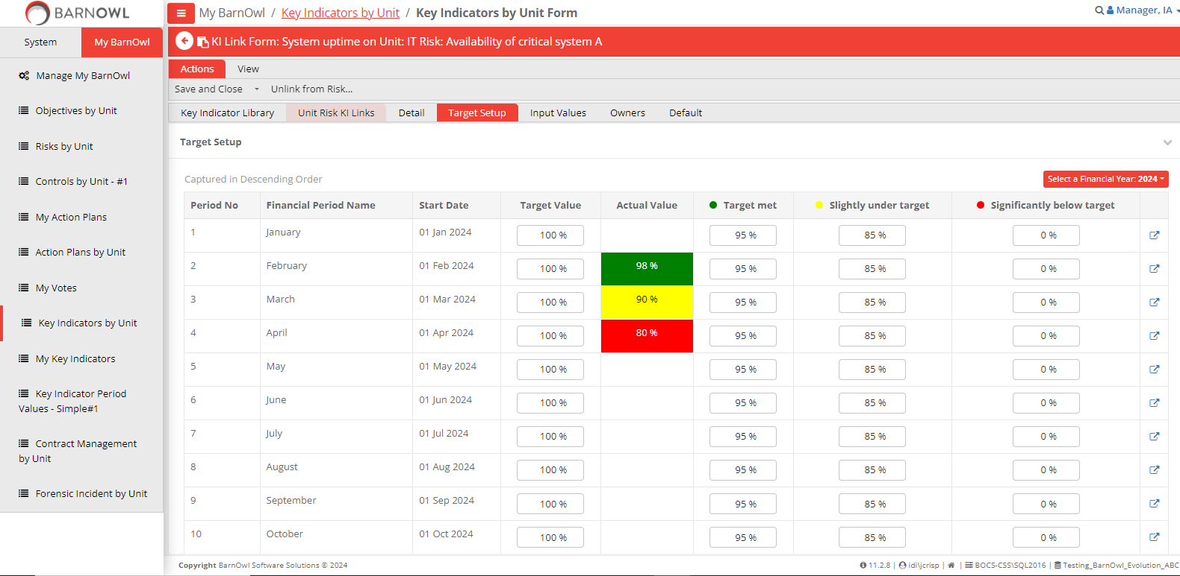
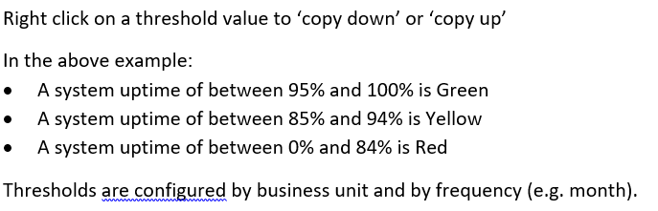
Step 2.3: Configure KI thresholds (per BU)

Slide 12
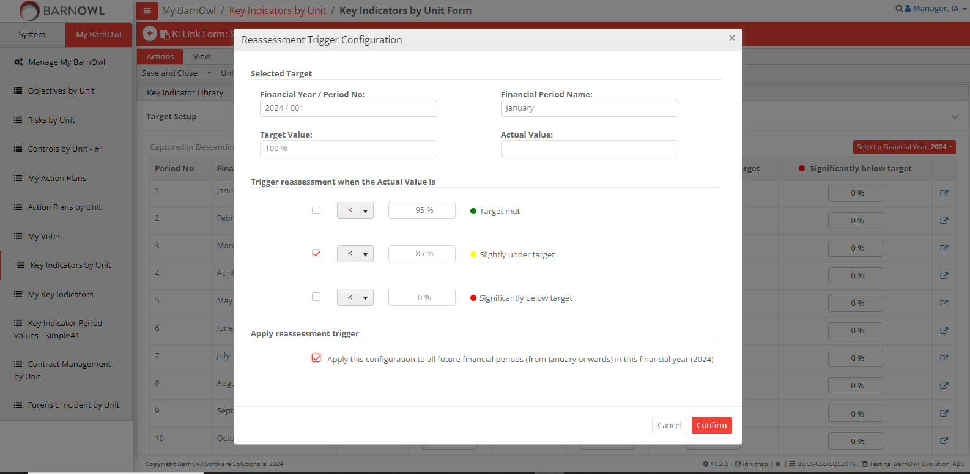
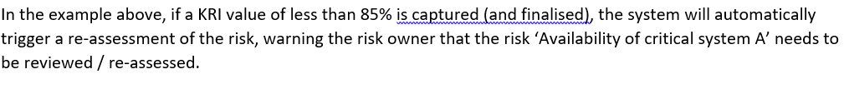
Step 2.4: Configure re-assessment triggers

Slide 13
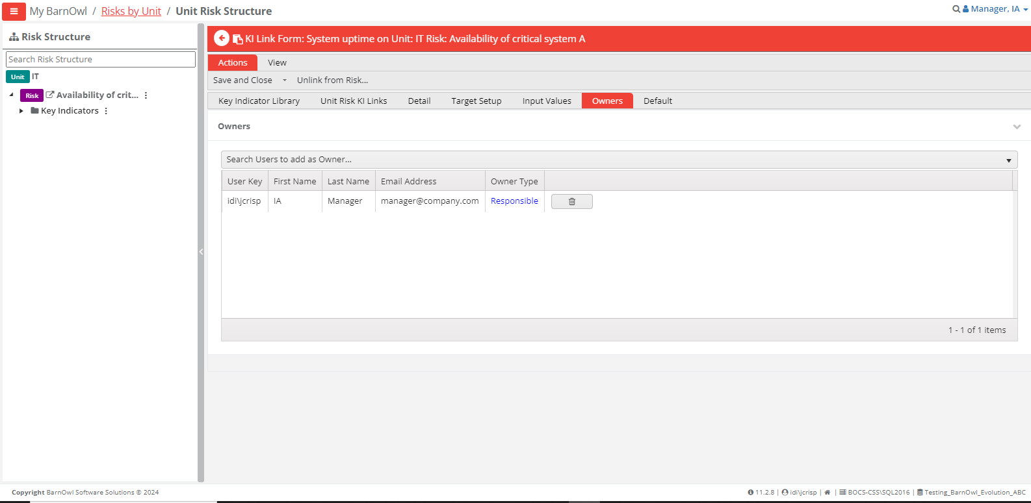
Step 2.5: Assign an Owner to the KI

Slide 14
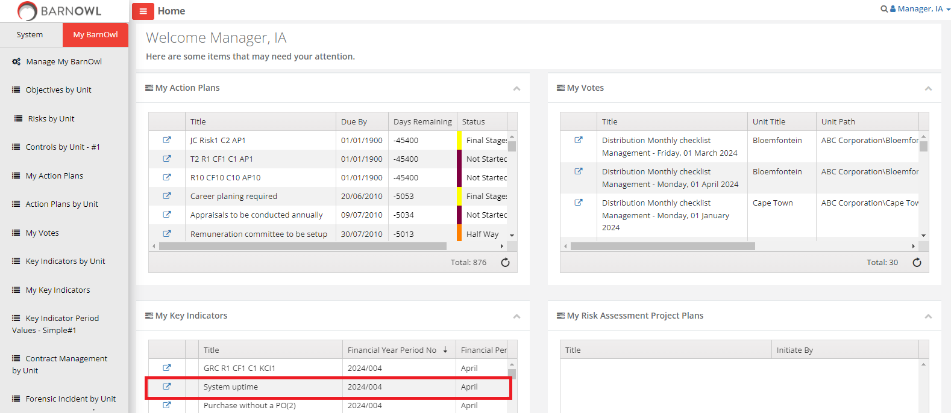
Step 3.1: Capture Key Indicator values – landing page (KI Owner)

Slide 15
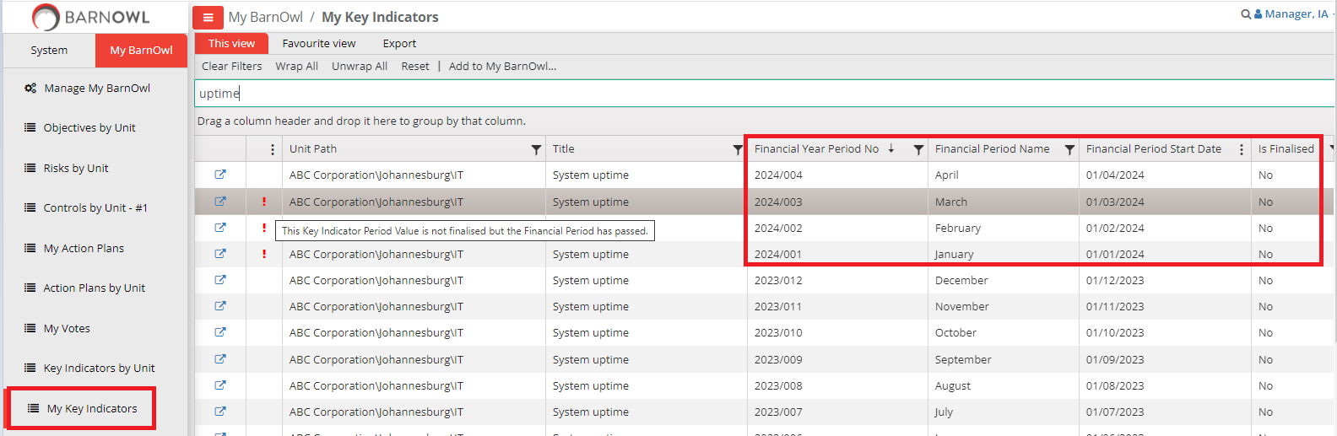
Step 3.2: My Key Indicators (KI Owner)

Slide 16
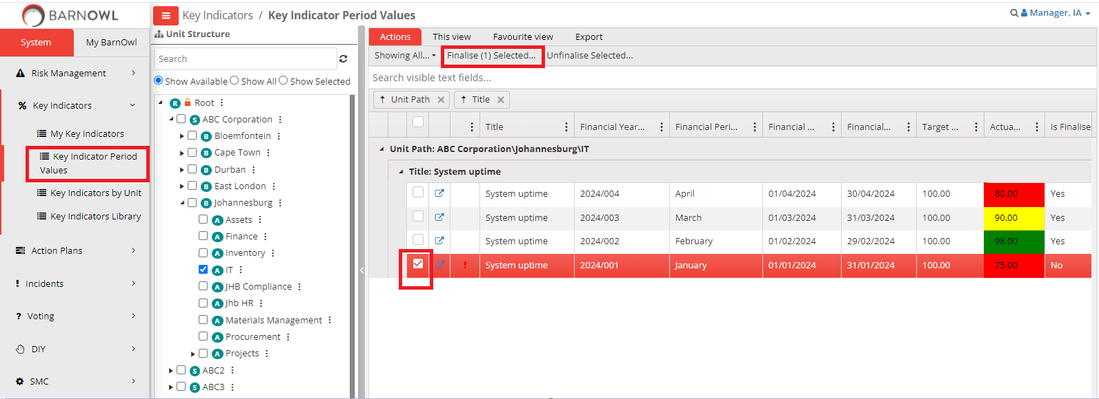
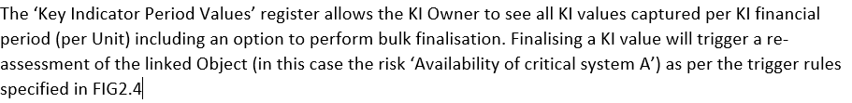
Step 3.3: Key Indicator Period Values

Slide 17
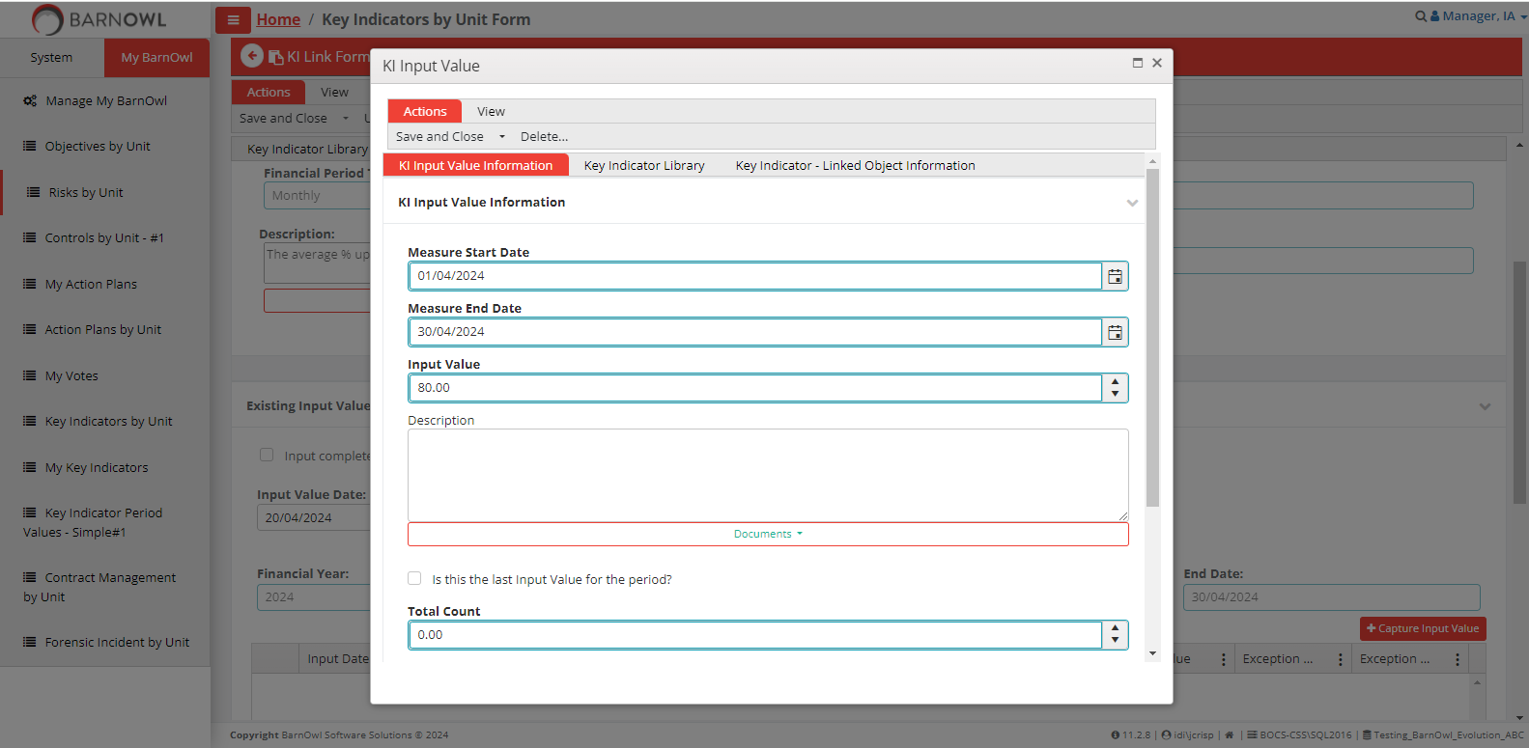
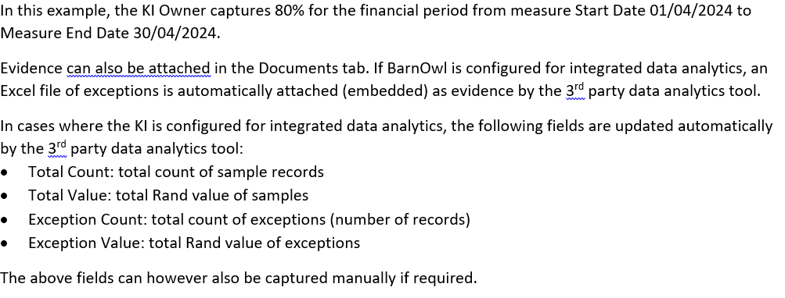
Step 3.4: Capture a KI value (KI Owner)

Slide 18
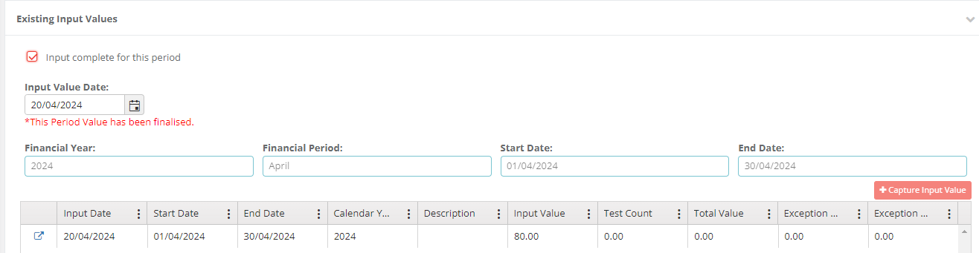
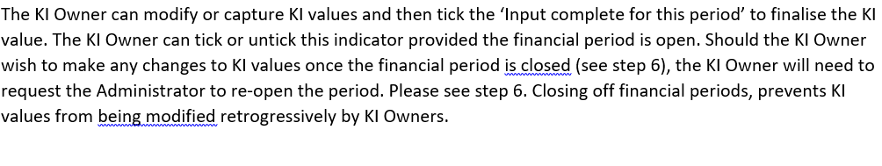
Step 3.5: Finalise the KI value (KI Owner)

Slide 19
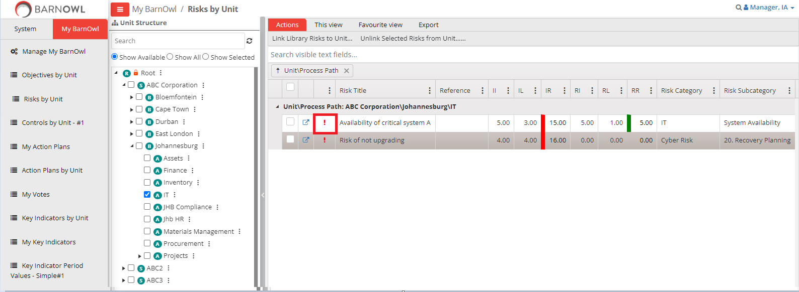
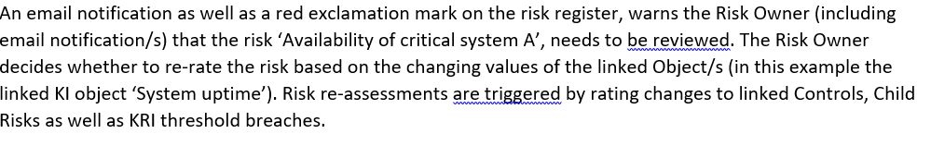
Step 4.1: Risk re-assessment (Risk Owner)

Slide 20
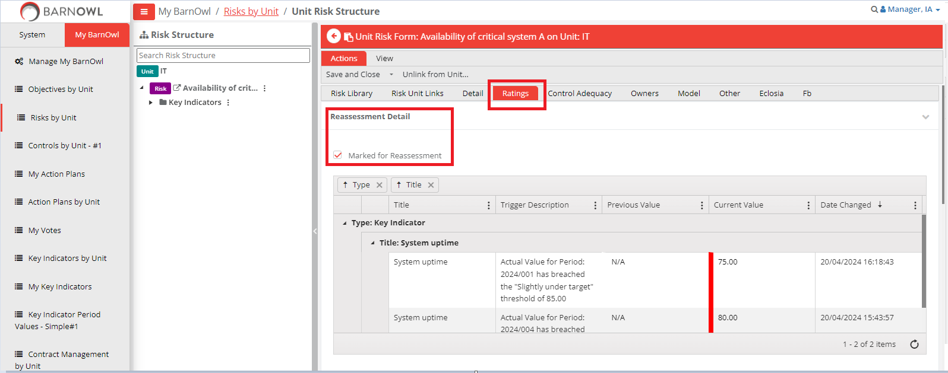
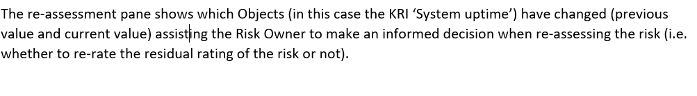
Step 4.2: View re-assessment details (Risk Owner)

Slide 21
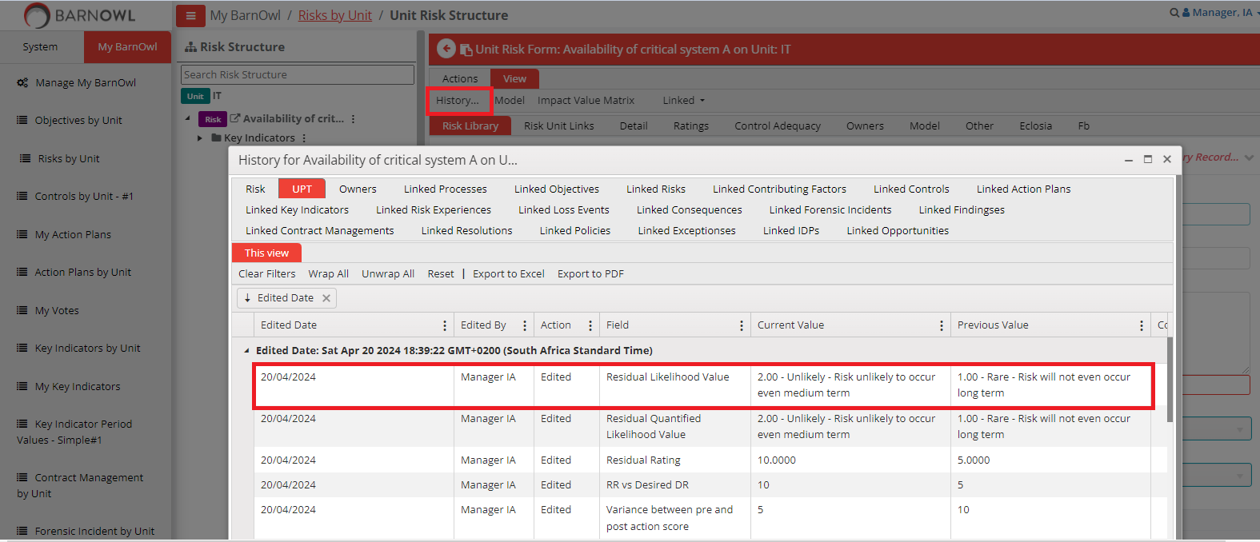
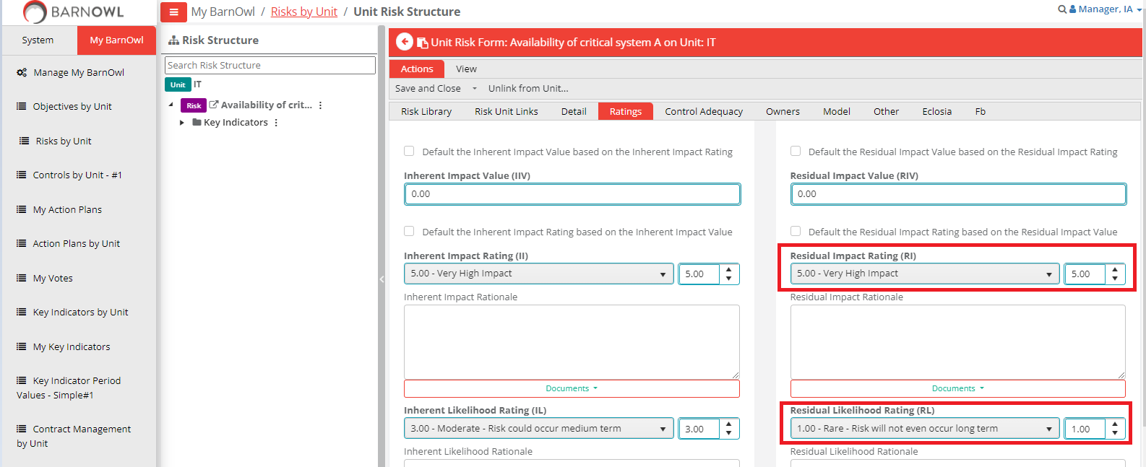
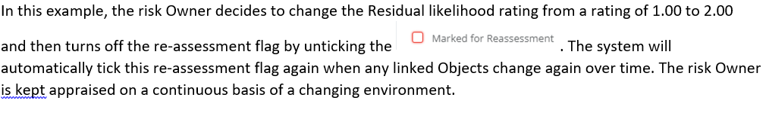
Step 4.3: Decide whether to re-rate the risk (Risk Owner)

Slide 22
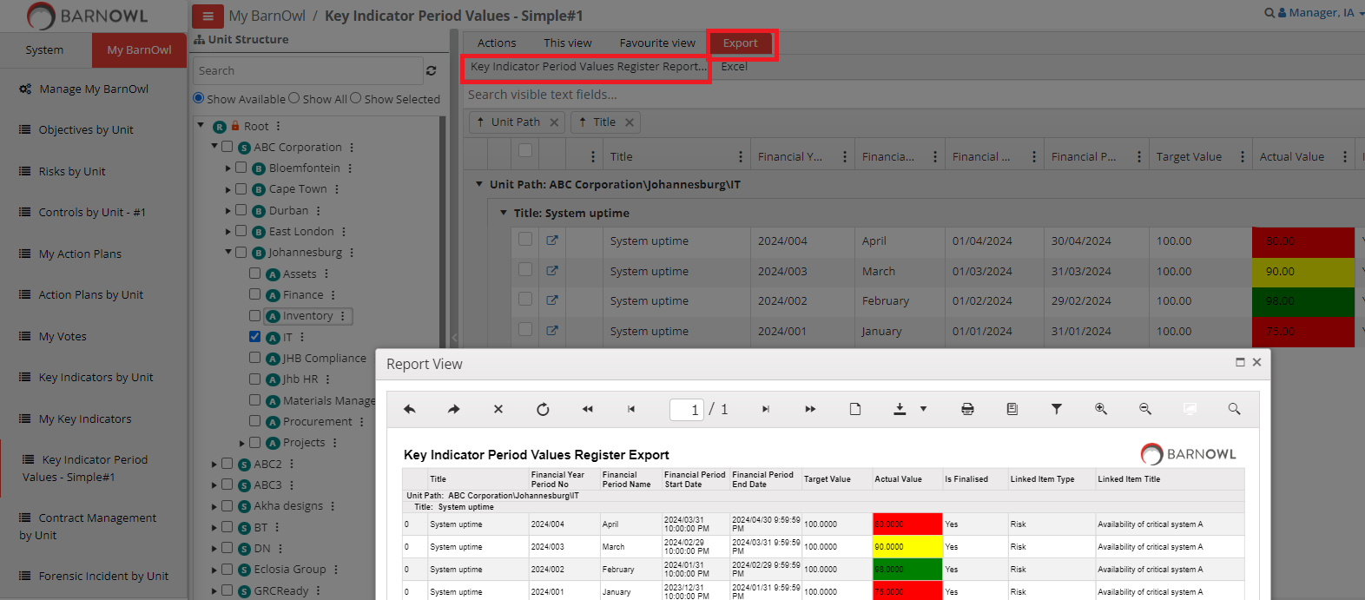
Step 5.1: Key Indicator monitoring and reporting – built-in reports

Slide 23
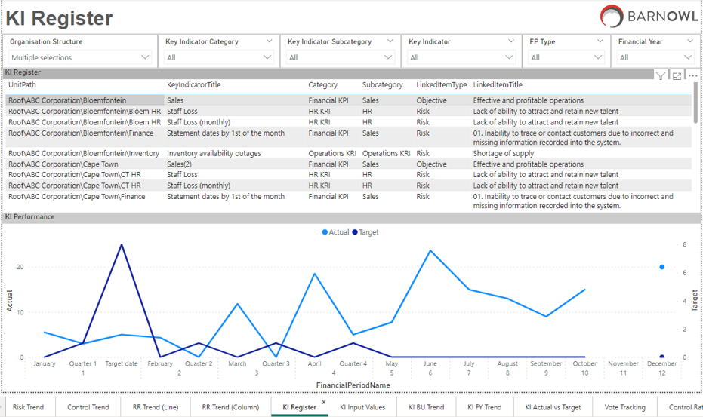
Step 5.2: Key Indicator monitoring and reporting – Power BI reports

Slide 24
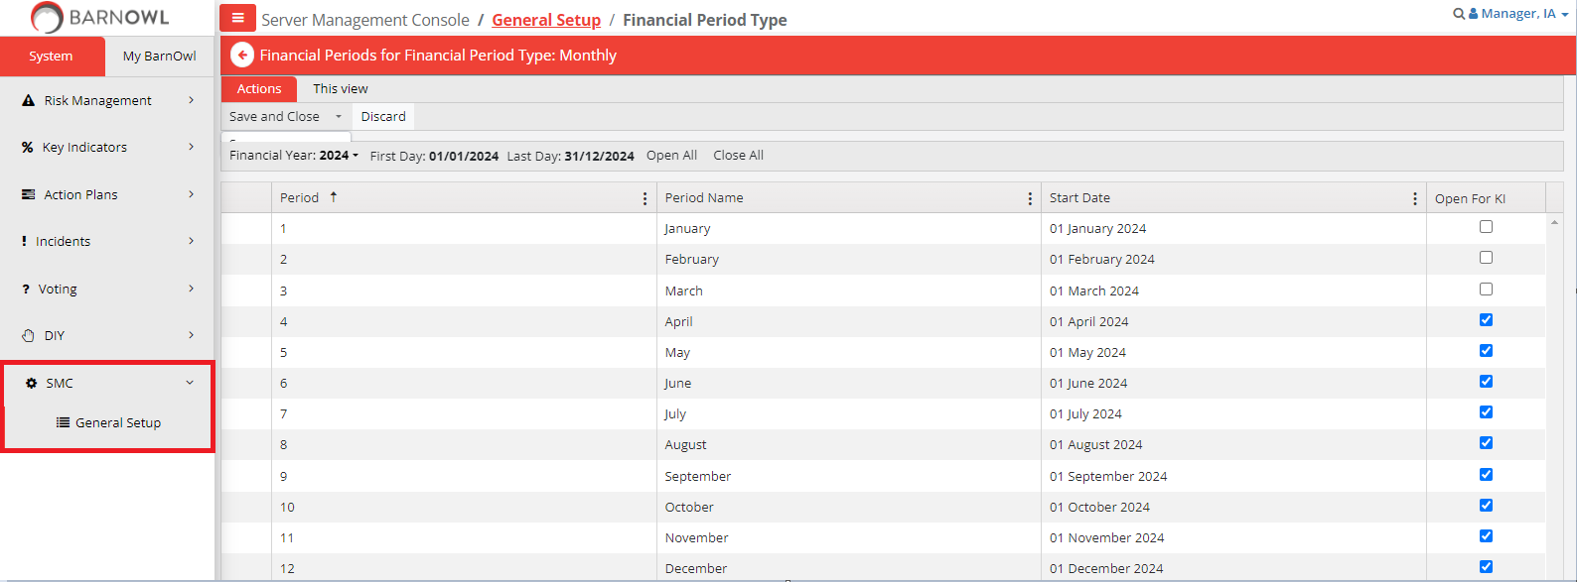
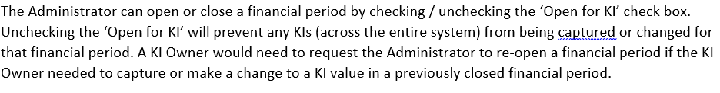
Step 6: Close a Key Indicator period (Administrator)

Slide 25
Recap
  Configuring a financial period: For example 1 April 2024 to 31 March 2025 aligns KI reporting with your financial year
  Closing off KI periods: simple and effective way to prevent KI values being changed in previous periods
  Capturing of KI values by Owners: simplified interface for capturing KI values in BarnOwl’s free web-portal (intranet)
  Re-assessment triggers: Automatic re-assessments triggers when a KI threshold is breached (Objectives, Risks and Controls)
  Extensive reporting: built-in KI report as well as Power BI dashboards (drill down, trends etc)
  Key Indicators: provide a strategic early warning system, driving preventative and predictive capability, with real time insights, facilitating effective business decision making and business improvement.

Slide 26
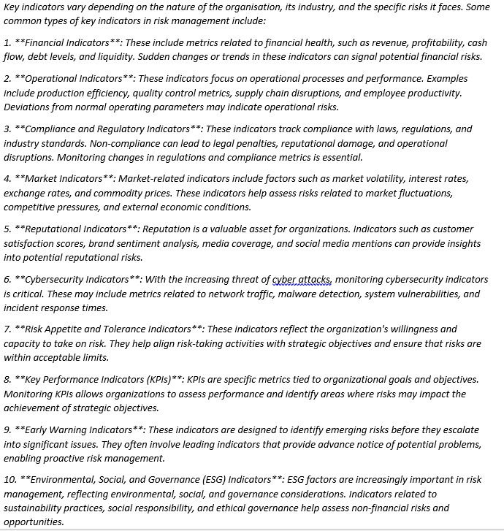
Examples of Key Indicators
Source: ChatGPT

Slide 27
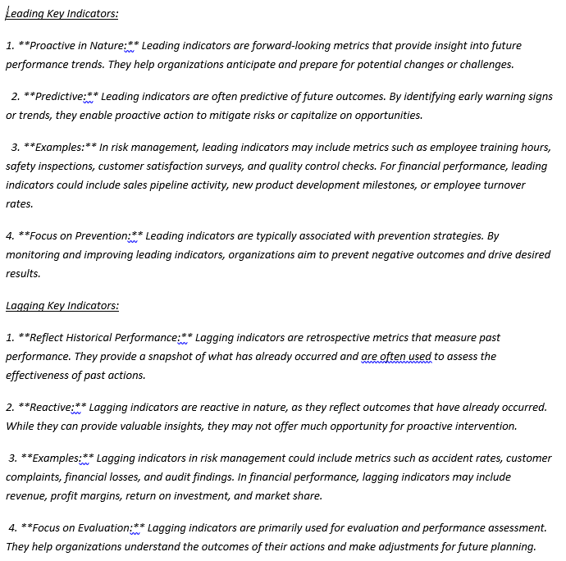
Types of Key Indicators
Source: ChatGPT

Slide 28
How do I upgrade to V11?
  New versions of BarnOwl contain not only the latest new features, but also performance enhancements and fixes. https://barnowl.co.za/knowledge-base/tip-of-the-month/frequently-asked-questions-about-upgrading-barnowl/
  The upgrade process is fully automated with a wizard-driven approach enabling Clients to upgrade themselves. This enables the Client to plan the timing of their Upgrade taking into consideration your IT approval processes, your change management process (i.e. communicating the impact of the new version to your users) and booking BarnOwl training where required:
  Step 1: Download the ‘Whats New’ document to view what changes have been made to this version. The What’s new document includes links to the relevant topic in BarnOwl’s online help
  Step 2: Download BarnOwl’s minimum System Requirements document and confirm with your IT, that your IT environment conforms to the technical requirements. For example .net framework 4.8 is required for version 11
  Step 3: Download the Guides from the ‘Client Hub>Support Hub Login, Knowledge Base’ or request a copy from BarnOwl Support.

Slide 29
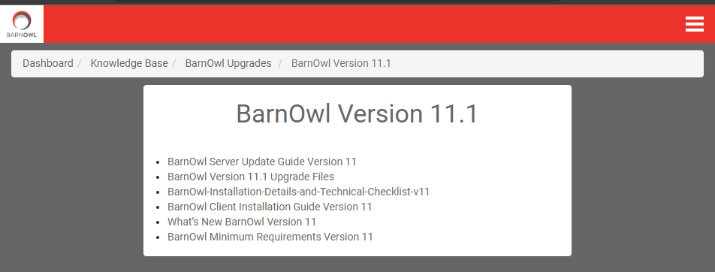
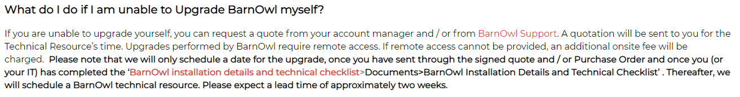
How do I upgrade to V11 (Continued)
  Step 4: Ask your IT to download the Upgrade files and follow the Update Guides: Client Hub>Support Hub Login, Knowledge Base:
Make full backups of all the databases which will be upgraded. This includes Production and UAT/Training databases.
Ideally a UAT environment should be upgraded, tested and signed off by the Client BarnOwl champion before the Production environment is upgraded.
Warn your users that BarnOwl will not be available for the duration of the upgrade. It is important that users don’t attempt to log in to BarnOwl while you are upgrading the version.

Slide 30
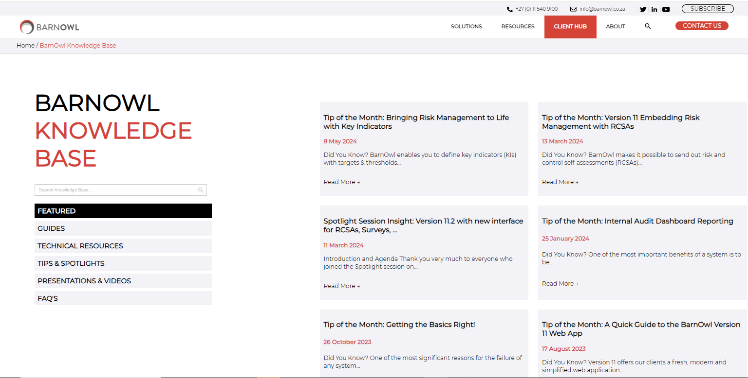
BarnOwl website
https://barnowl.co.za/barnowl-knowledge-base/

Slide 31
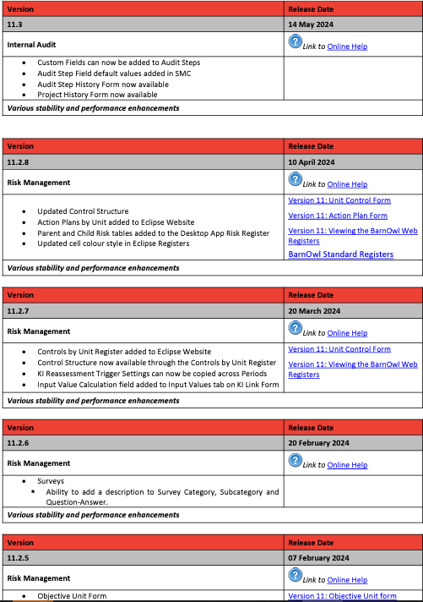
What's new document: https://barnowl.co.za/wp-content/uploads/2024/06/Whats-New-in-BarnOwl-1.pdf

Slide 32
Thank You
+27 11 540 9100 (office)
support@barnowl.co.za
+27 11 540 9112 (help desk)
https://barnowl.co.za/barnowl-knowledge-base/

