Slide 1

BarnOwl V11.2
FULLY INTEGRATED RISK MANAGEMENT, COMPLIANCE AND AUDIT
SOFTWARE
BarnOwl V11.2 spotlight
29 February 2024
Presented by Jonathan Crisp
Click here for session recording

Slide 2

BarnOwl V11.2 - Agenda
BarnOwl introduction
BarnOwl Desktop and BarnOwl Web
Features of BarnOwl v11.2
Demo BarnOwl v11.2: Surveys, Questionnaires, RSAs, CSAs, Key Indicators (KIs)
Demo BarnOwl v11.2 Power BI
How do I upgrade to BarnOwl v11?
Conclusion

Slide 3
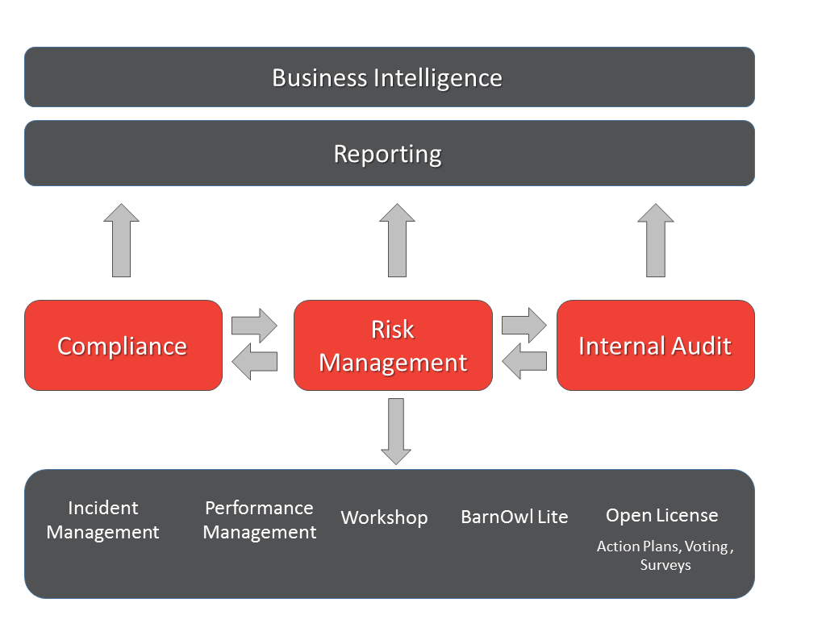
Introduction - BarnOwl integrated modules

Slide 4
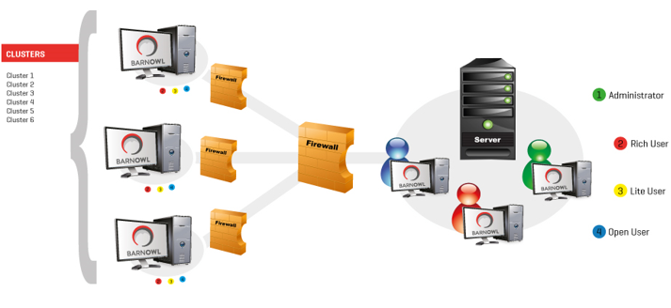
Introduction - Types of user and BarnOwl user interface (UI)
Admin User (Risk, Compliance and Audit): SMC remains in the Desktop app (rich). Setup of processes, org structure, votes, import compliance acts remain in the BarnOwl Desktop app.
Risk champion: will use BarnOwl Web (no longer BarnOwl Lite)
Compliance champion: will continue to use the BarnOwl Desktop app
Audit user: will continue to use the BarnOwl Desktop app
Open license user: will use the BarnOwl Web open license to respond to: Action Plans, Voting (RSA, CSA), Surveys, Questionnaires, Key Indicator inputs

Slide 5
V11 BarnOwl Desktop and BarnOwl Web
BarnOwl Desktop: Minor enhancements have been made to the BarnOwl desktop app. SMC will remain in the desktop app. BarnOwl Desktop will still work exactly the same way and continue to be used for administrative tasks.
BarnOwl Web: no longer BarnOwl Lite as V11.2 now incorporates much of BarnOwl’s extensive desktop app (‘rich’) risk functionality and will become the default user interface for risk management whilst the desktop app (‘rich’) will be used mainly for administrative tasks.
    Latest web-based technology
    Modern, clean-cut user interface
    Simplified navigation
    Standardised look & feel across all registers and forms (pages)
    Risk on a page simplifies risk taxonomy
    Enhanced Surveys, Questionnaires, RSAs, CSAs and KIs
    Performance enhancements
    BarnOwl Reporting
    BarnOwl query reporting
    Power BI (Risk, Voting, Surveys, Compliance, Audit) (directly off the BarnOwl database)
    SSRS (directly off the BarnOwl database)

Slide 6
Features of BarnOwl V11.2
  Surveys
  Info button for: category, sub category and question answer set
  View attached template documents
  Questionnaires
  Control self assessment (including reviewer) voting
  Recurrence with start and end date
  Reviewer enhancements
  Moderated action plans
  Proxy votes
  Risk self assessment voting
  Key Indicators
  Financial periods with targets and re-assessment rules
  My key indicator register with period finalisation
  Key indicator period values
  Action plan recurrence (with start and end date)
  Enhanced Reporting
  BarnOwl Web with custom queries register report
  SSRS (SQL Server Reporting Services) reporting
  Risk Power BI dashboard
  Voting (RSA, CSA) Power BI dashboard
  Surveys / Compliance Power BI dashboard
  Audit Power BI dashboard

Slide 7
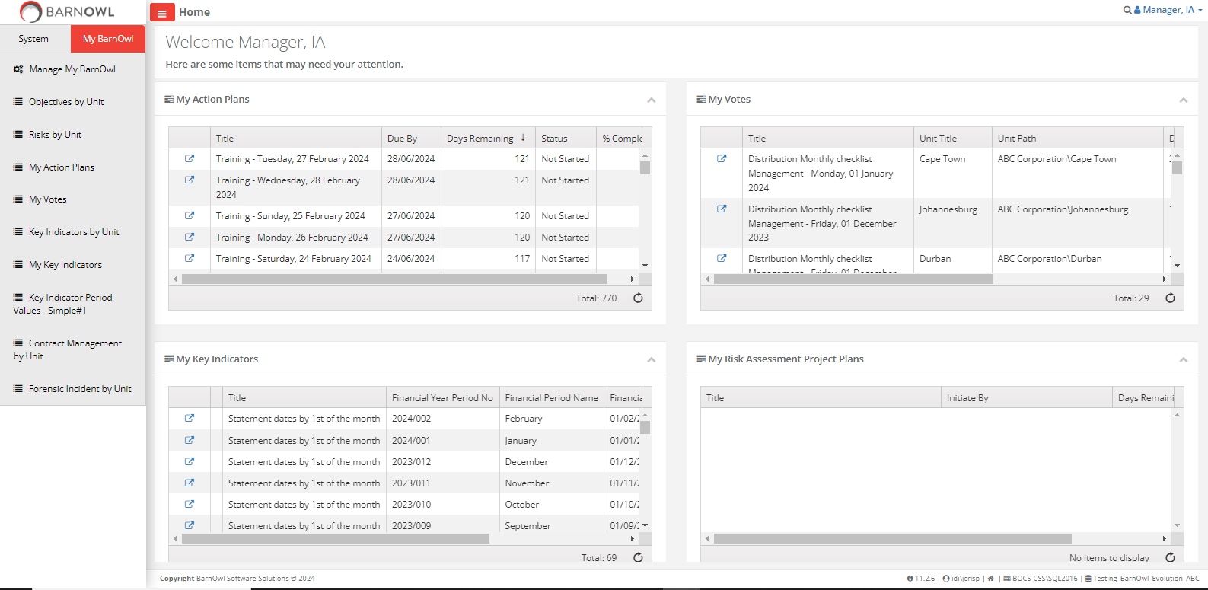
BarnOwl Web landing page

Slide 8
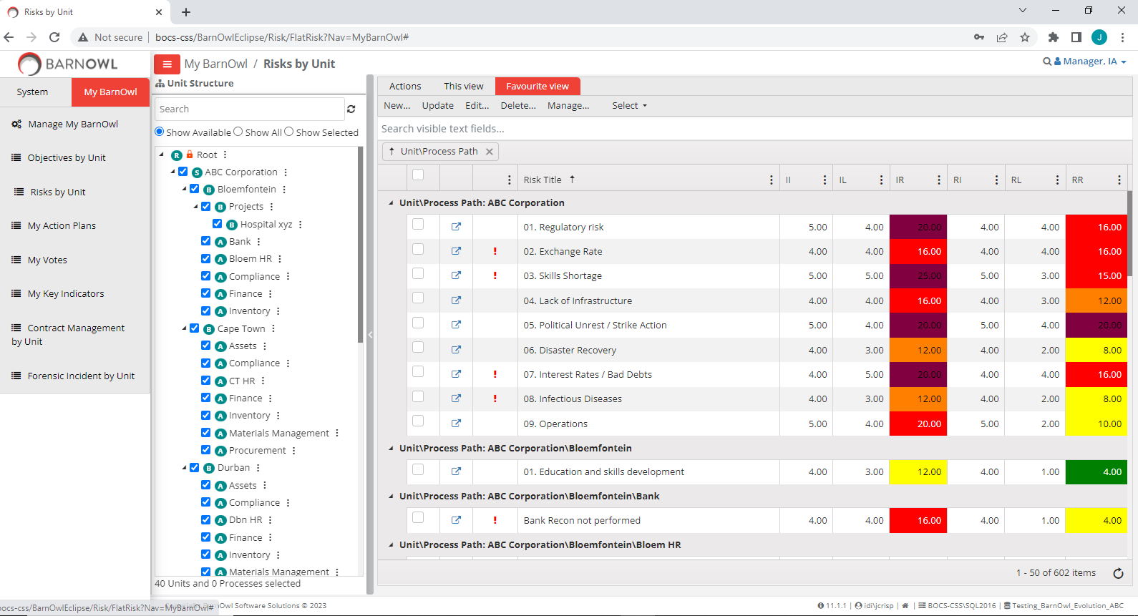
V11 new look & feel risk register

Slide 9
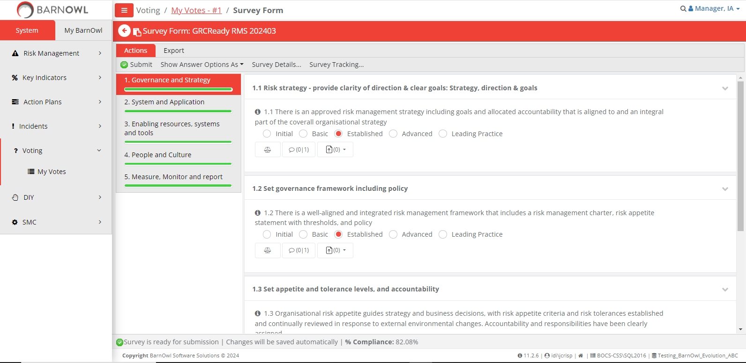
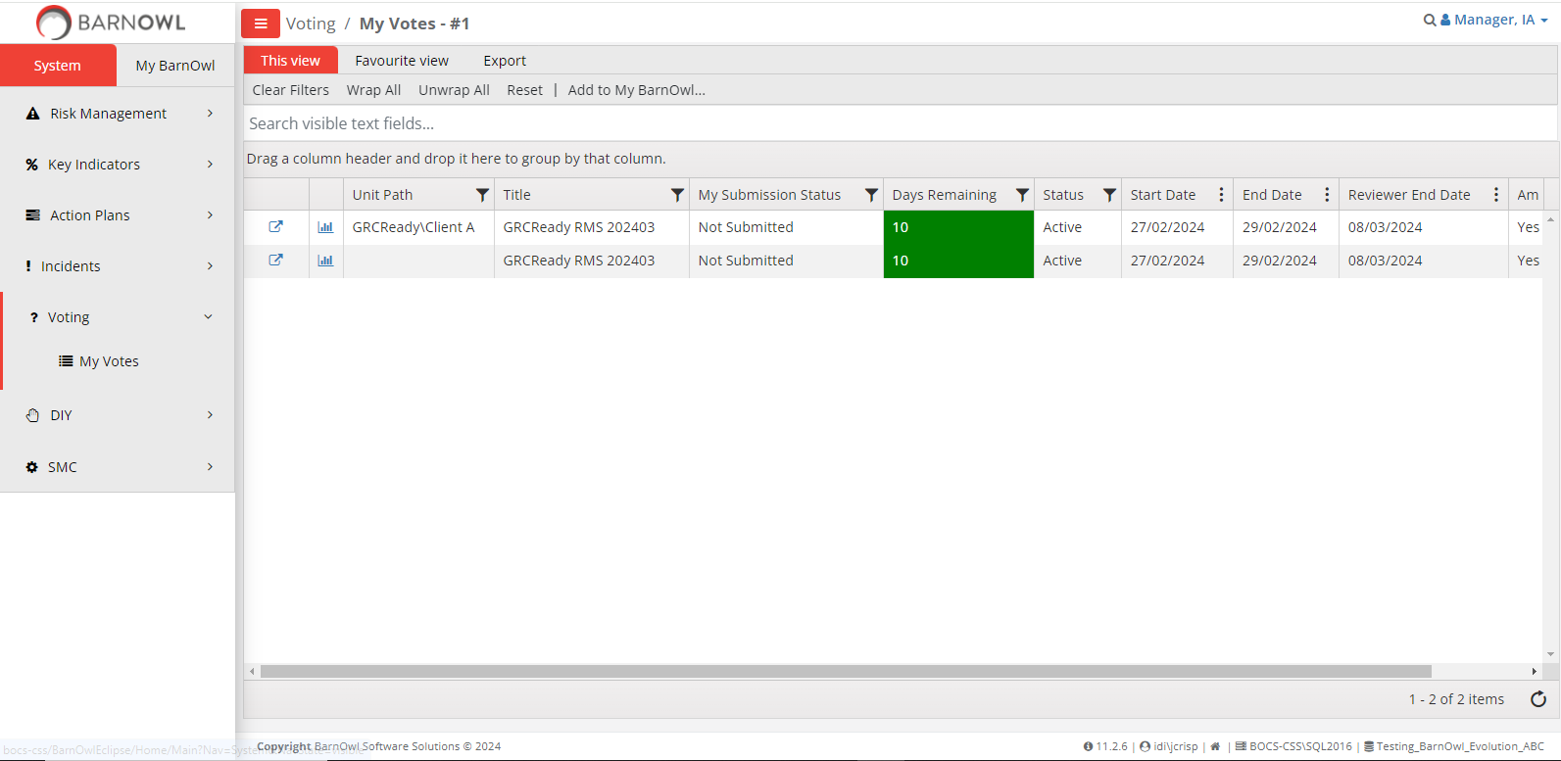
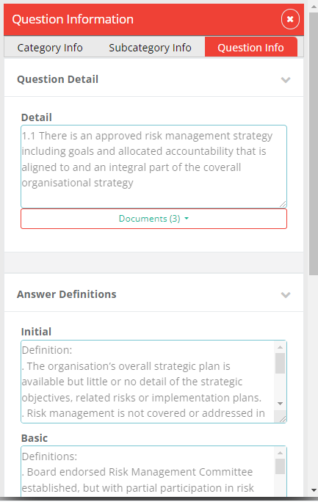
My Surveys

Slide 10
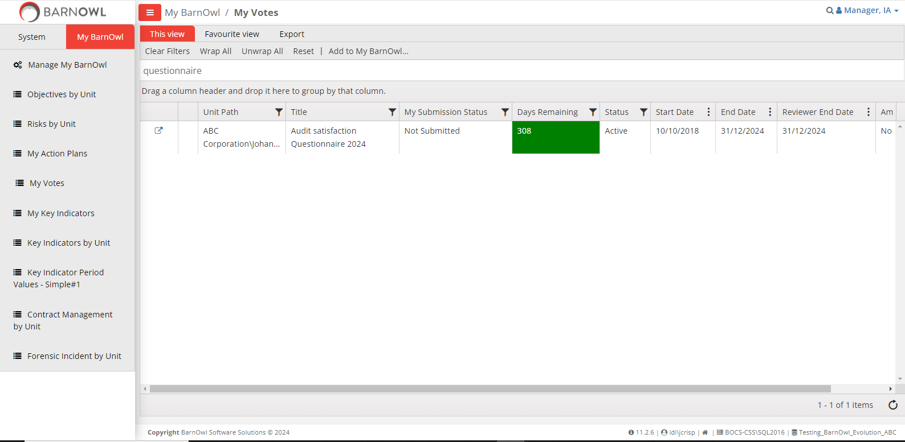
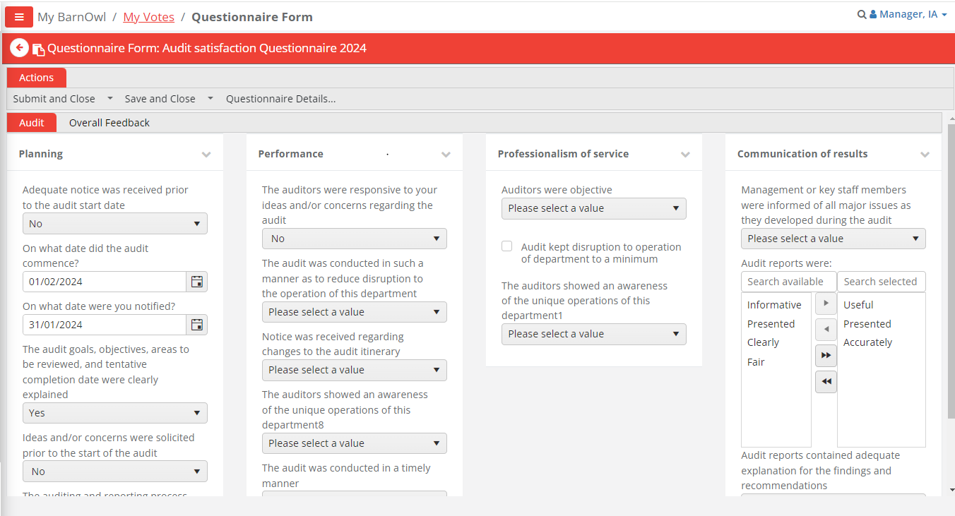
My Questionnaires

Slide 11
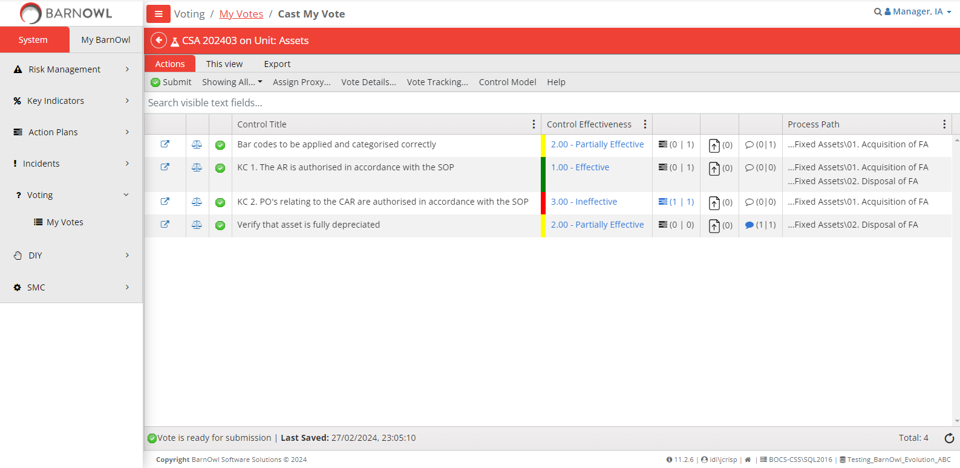
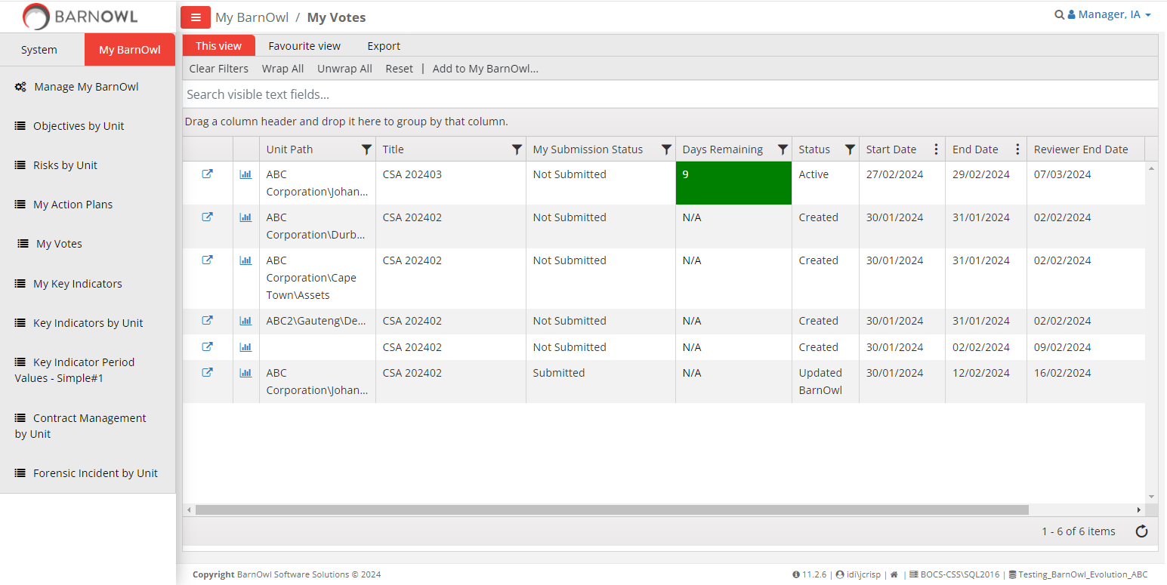
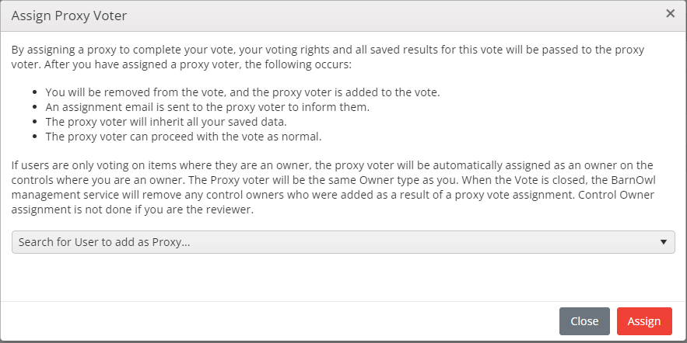
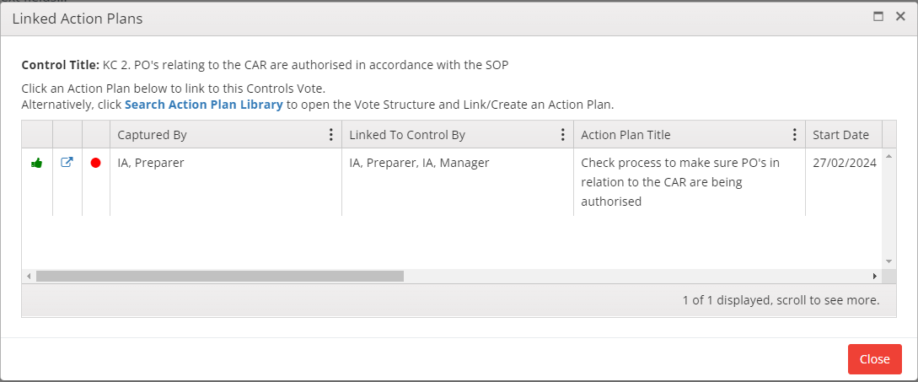
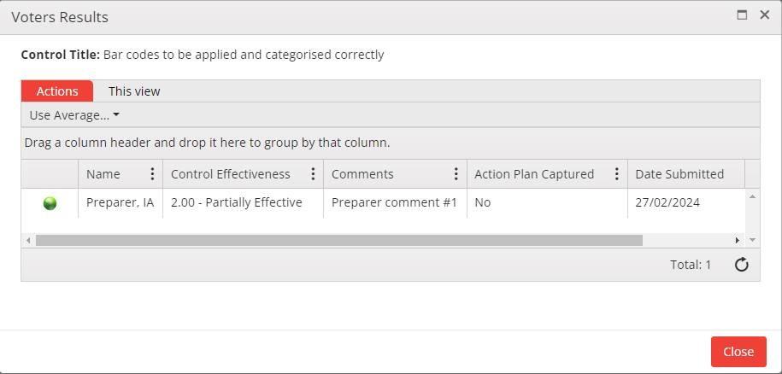
CSAs (Control Self Assessment)

Slide 12
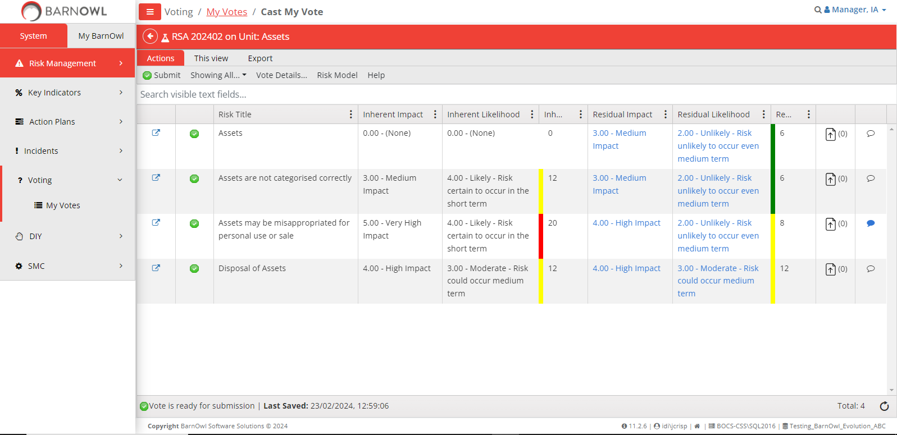
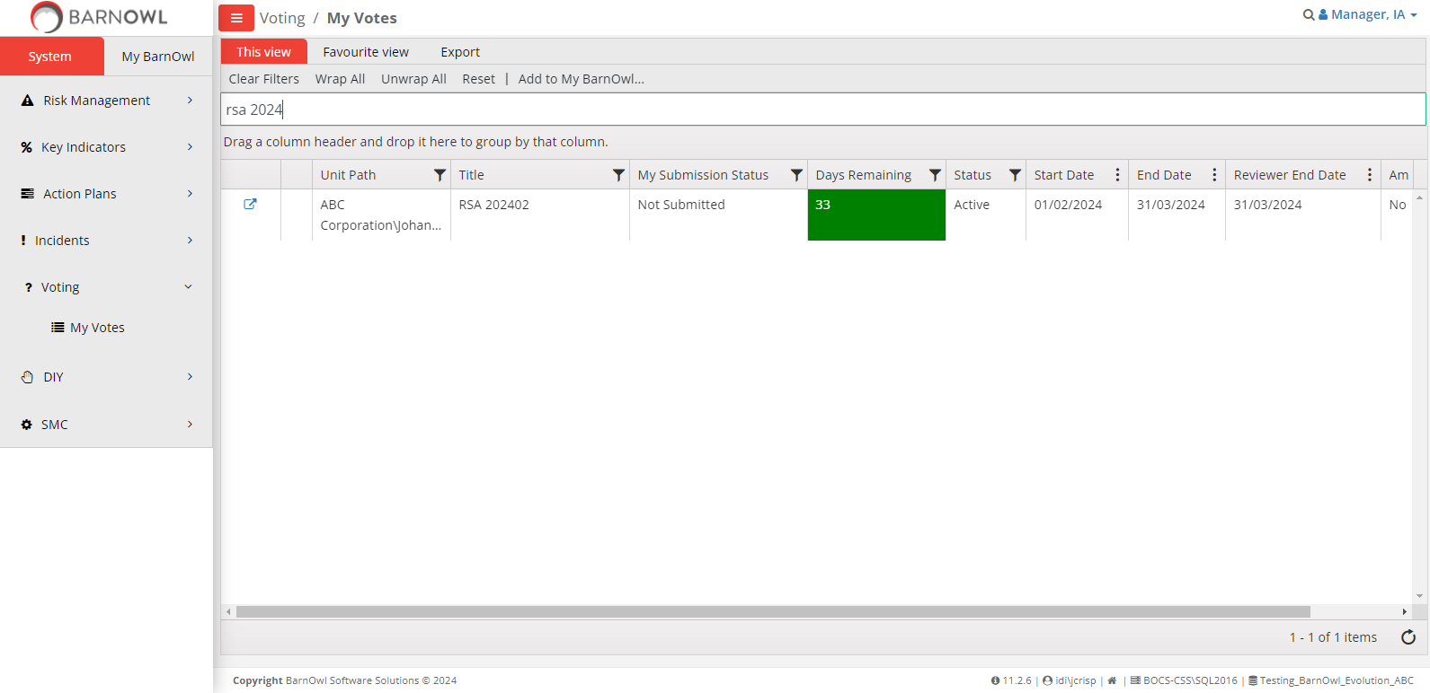
RSAs (Risk Self Assessment)

Slide 13
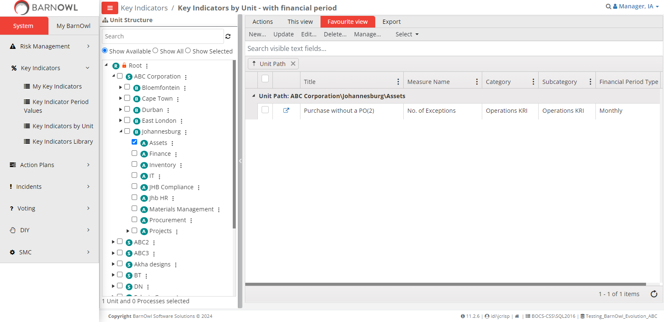
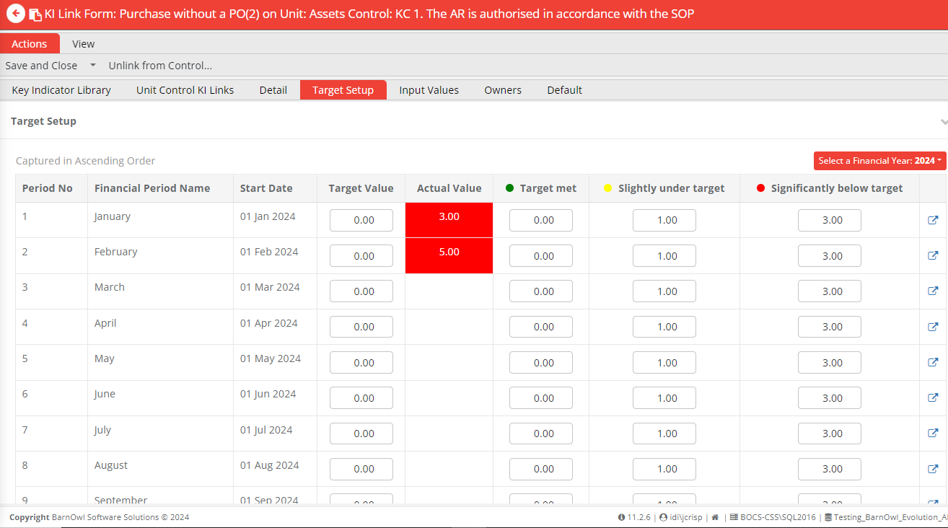
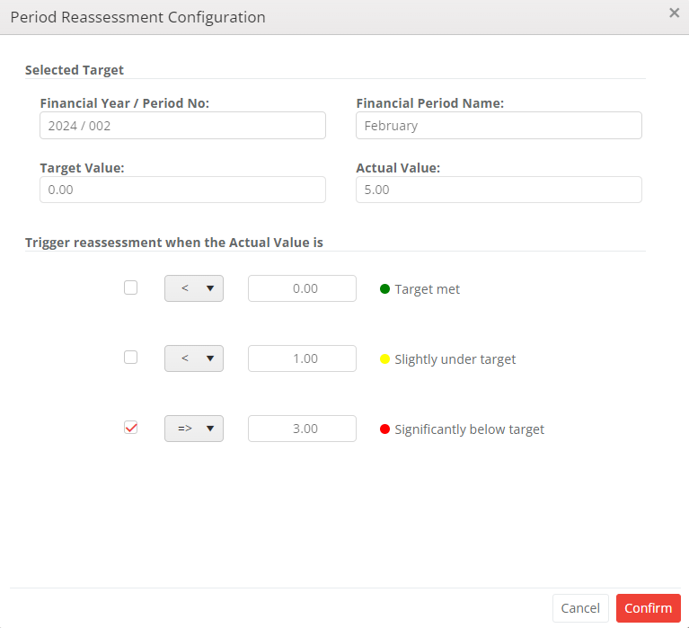
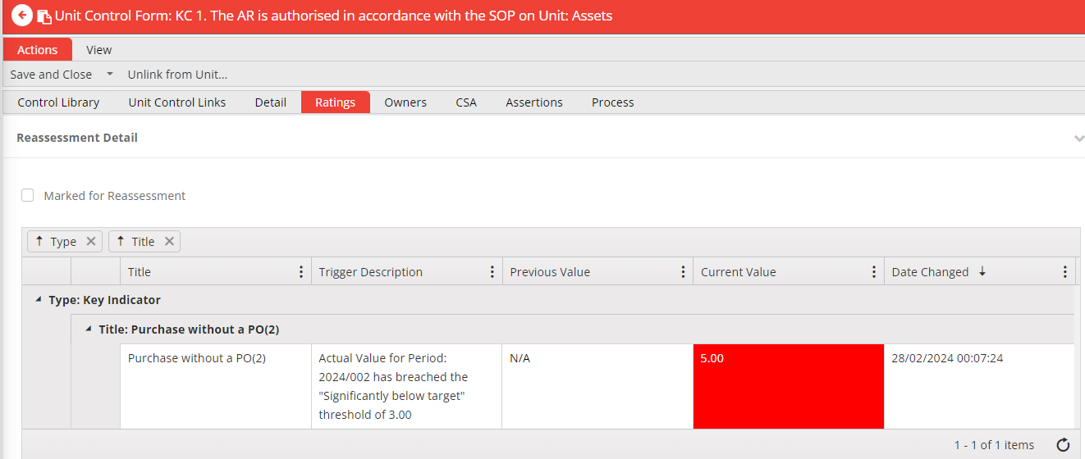
Key Indicators by Unit

Slide 14
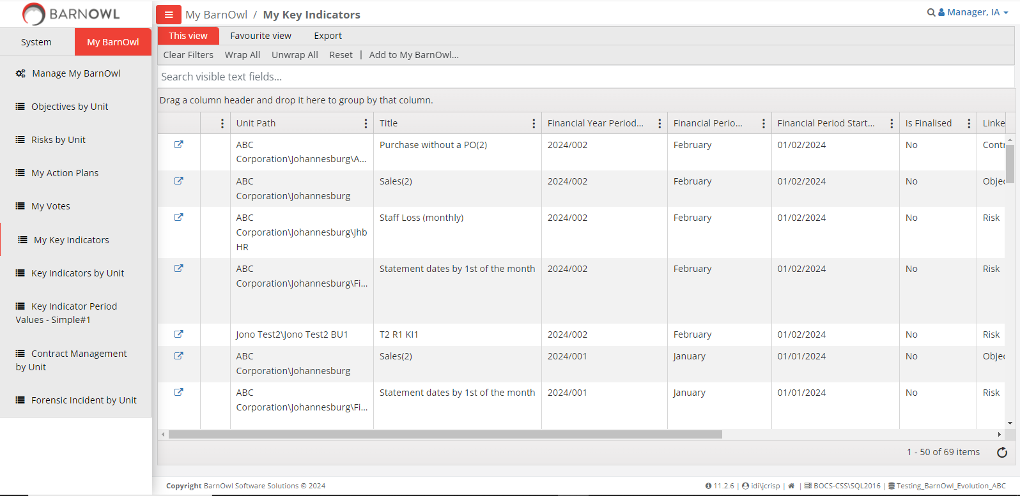
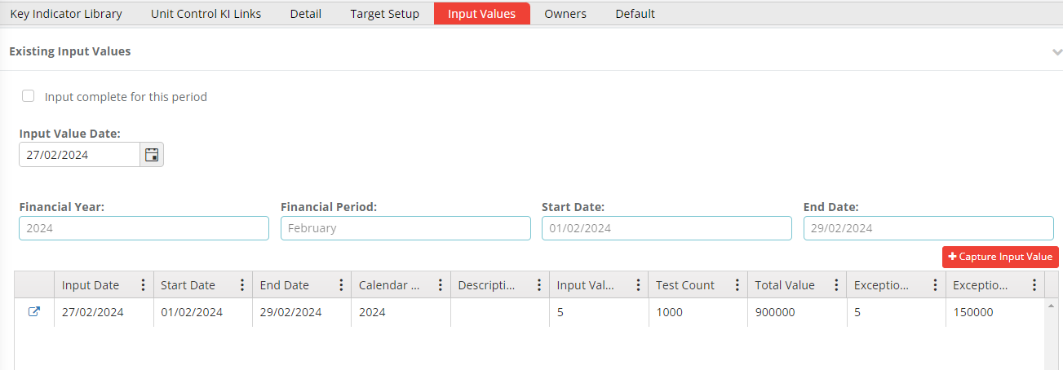
My Key Indicators (KPI, KRI, KCI) – showing my non finalised KIs

Slide 15
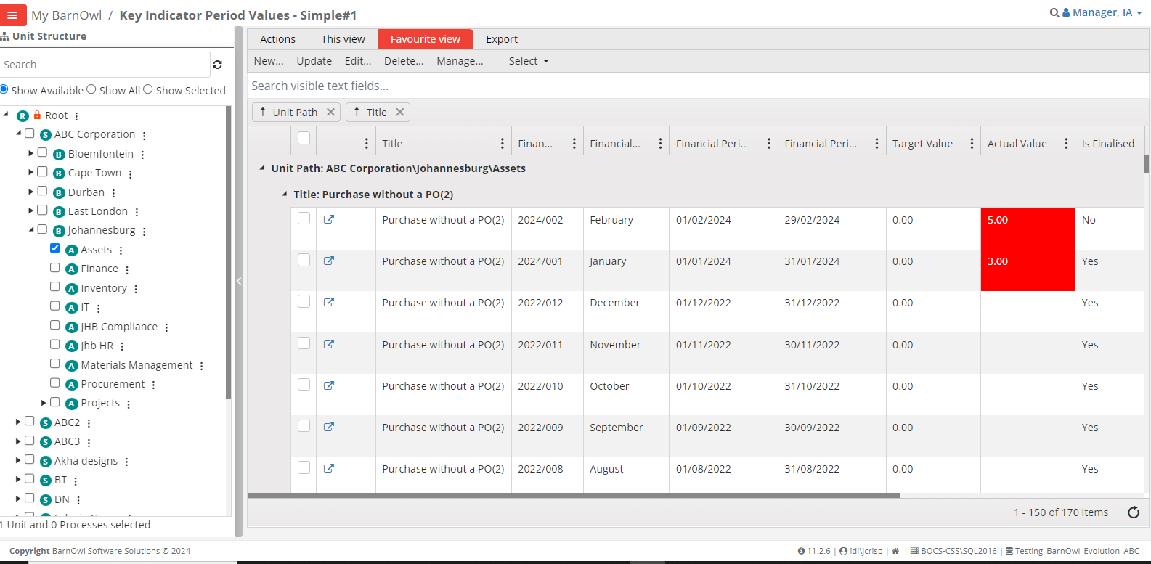
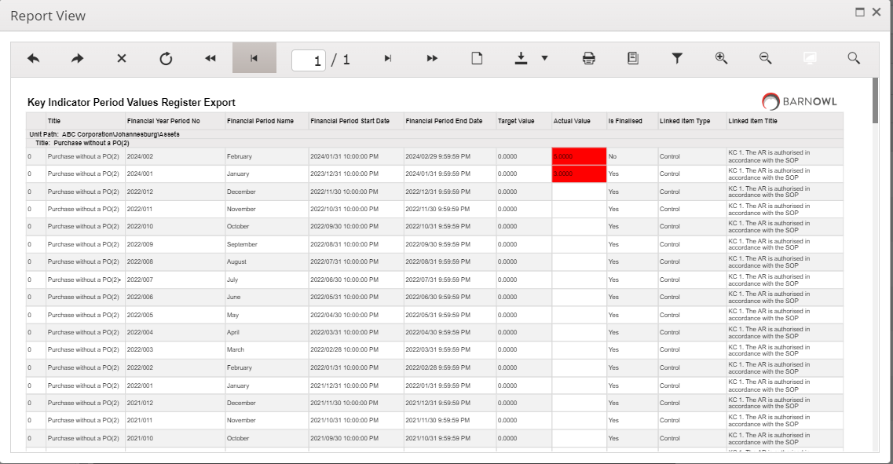
Key Indicator period values

Slide 16
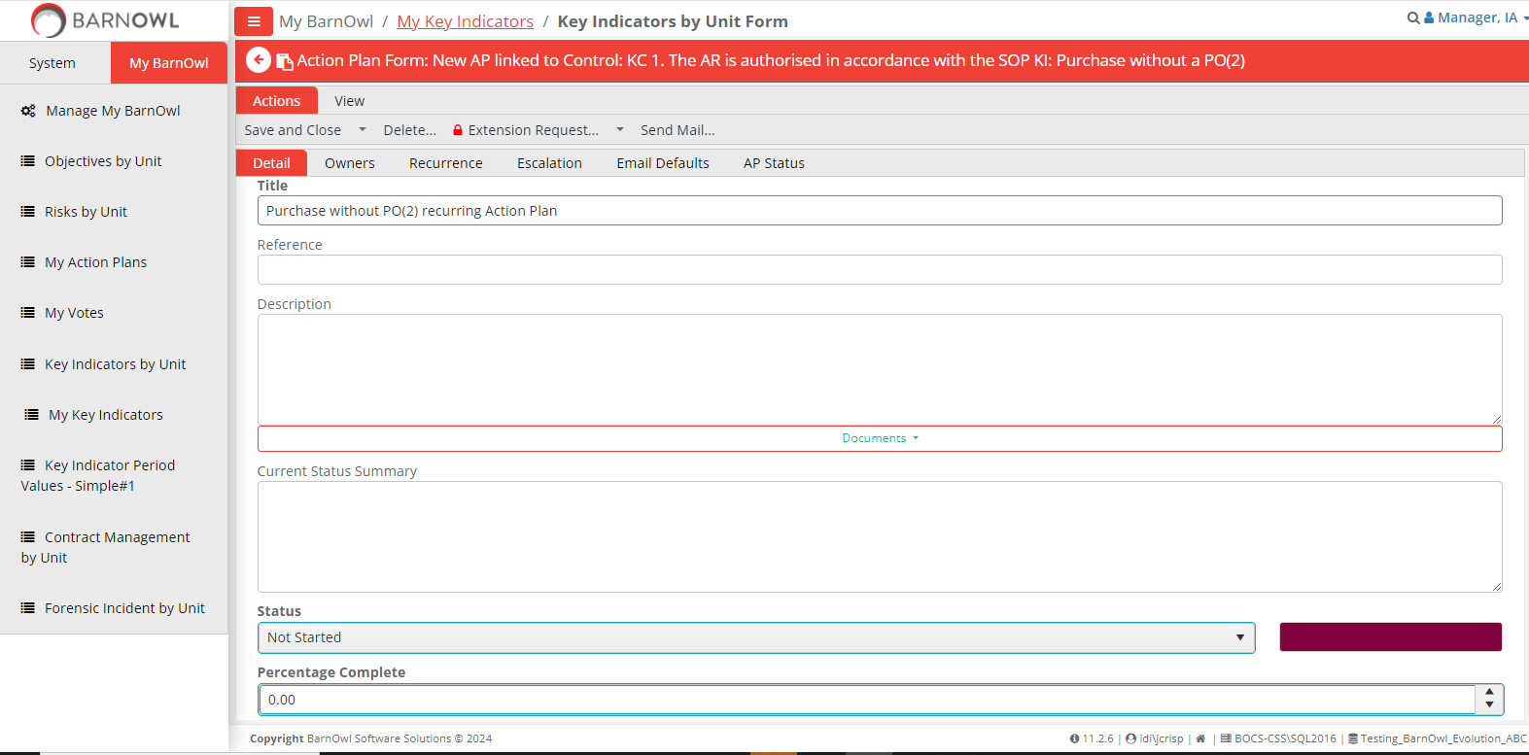
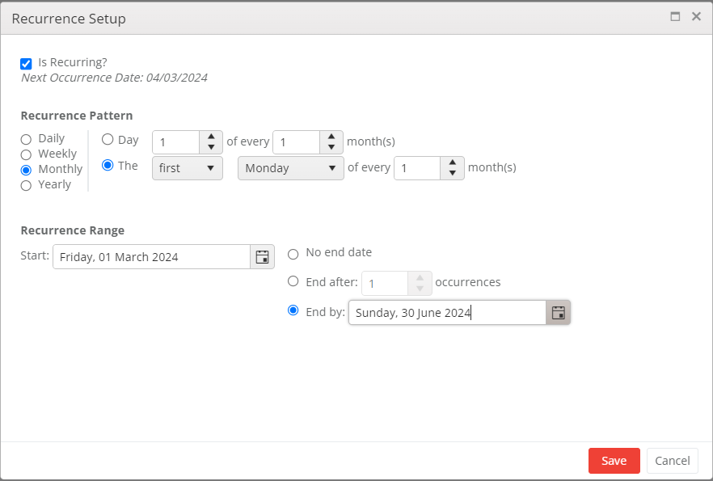
Recurrence enhancements - Action Plans, RSAs, CSAs, Surveys & Questionnaires

Slide 17
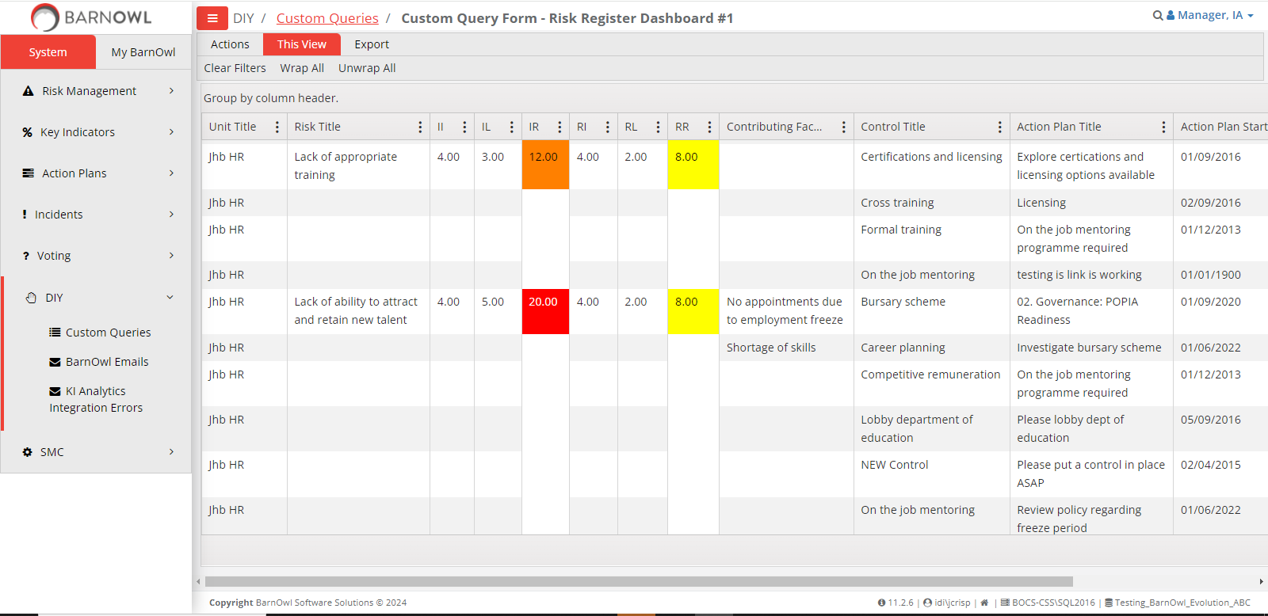
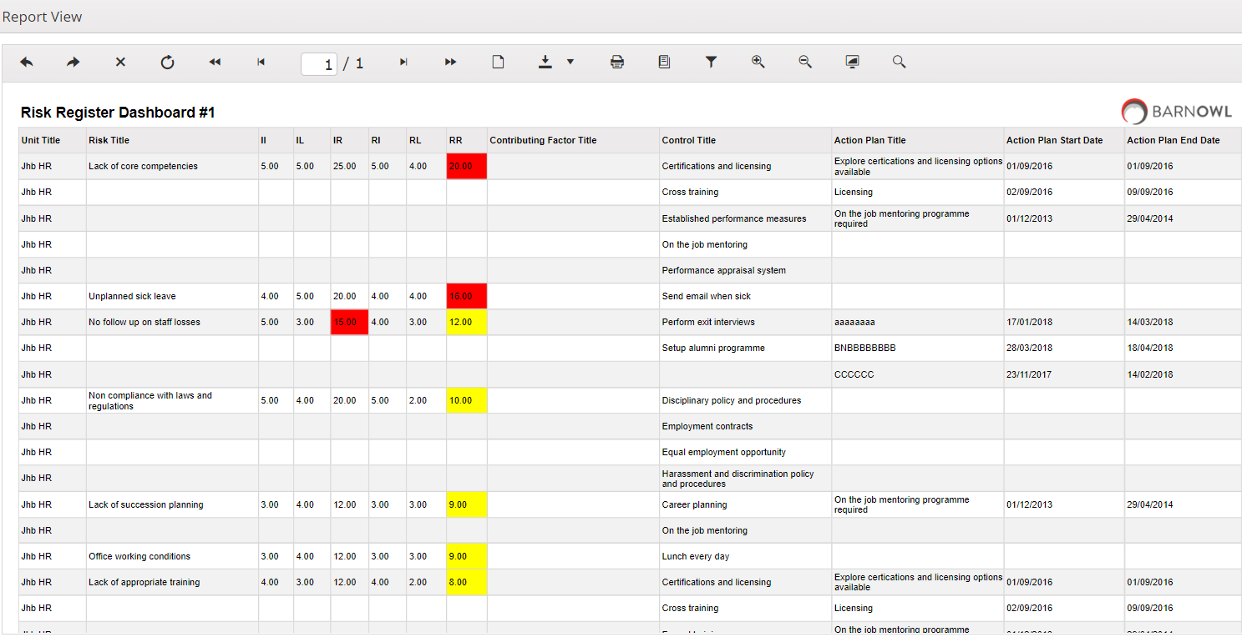
Standard Query Reports in BarnOwl Web

Slide 18
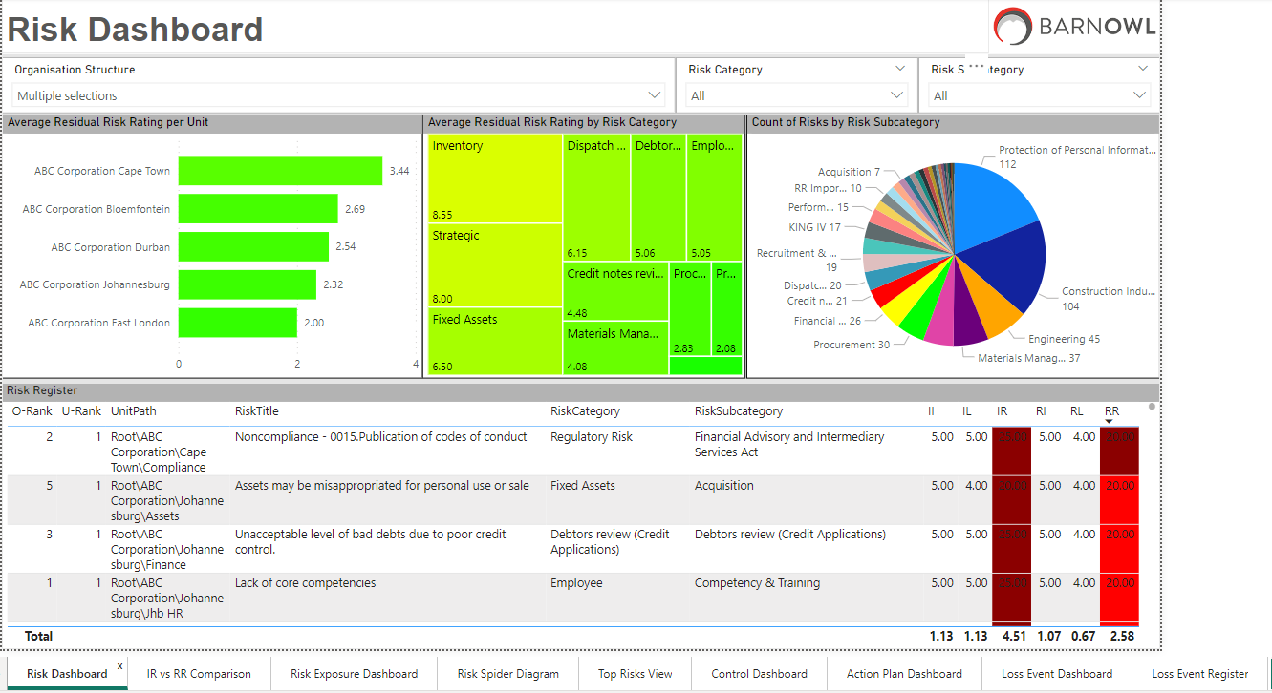
Standard Power BI Risk dashboard

Slide 19
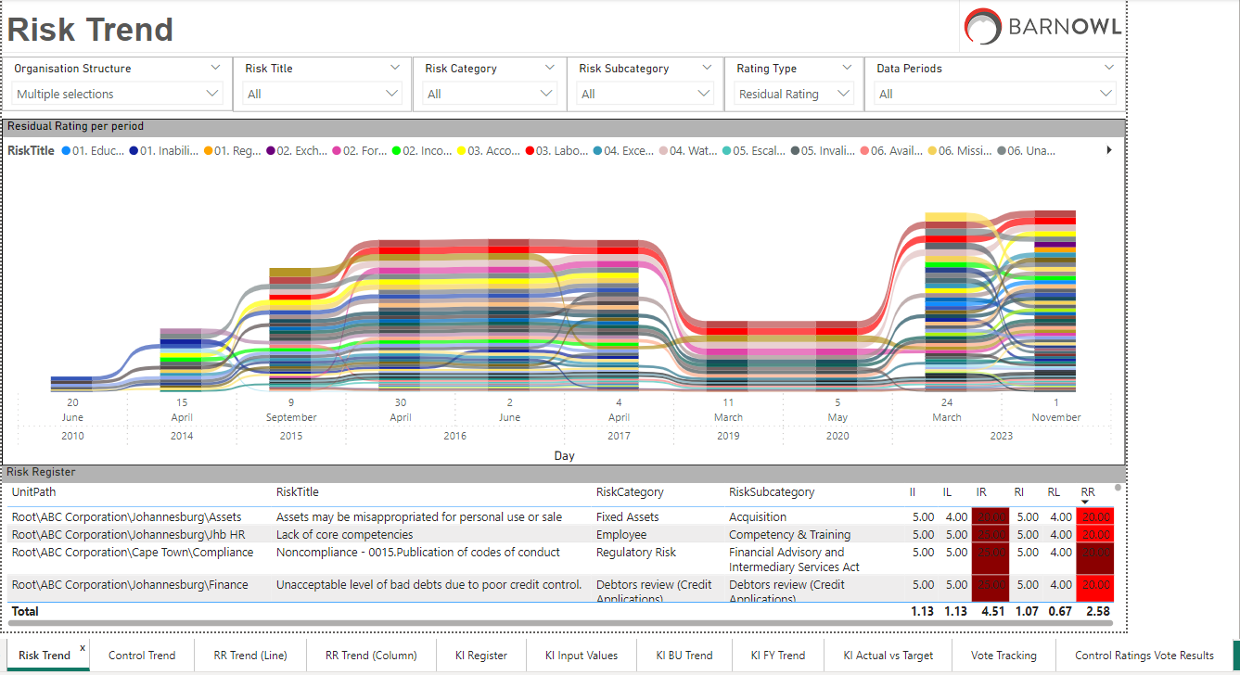
Standard Power BI Risk dashboard

Slide 20
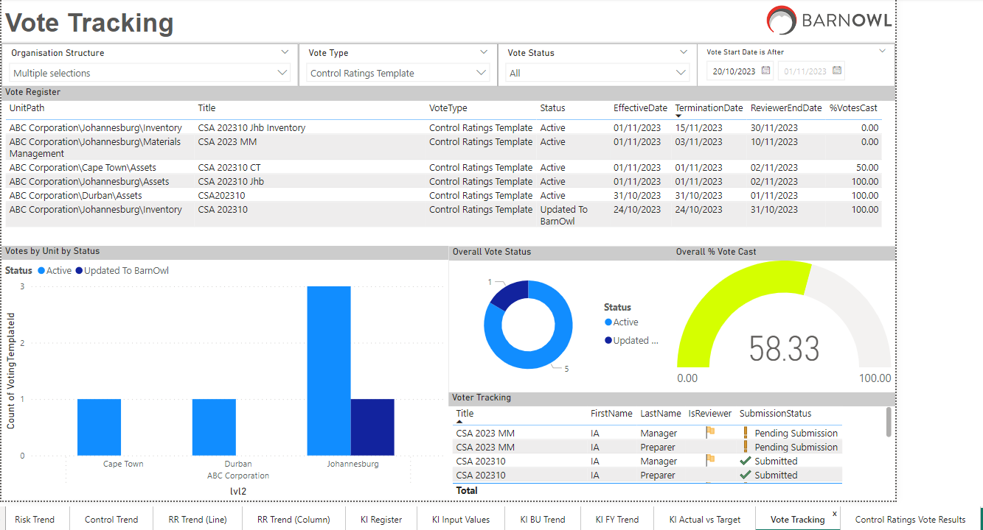
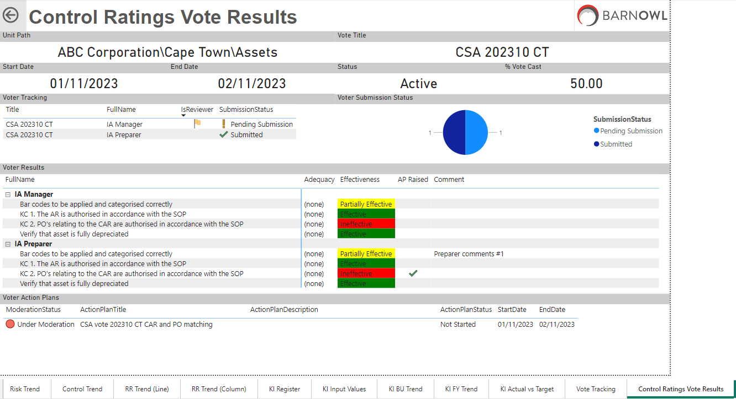
Standard Power BI Risk dashboard – Vote tracking dashboard

Slide 21
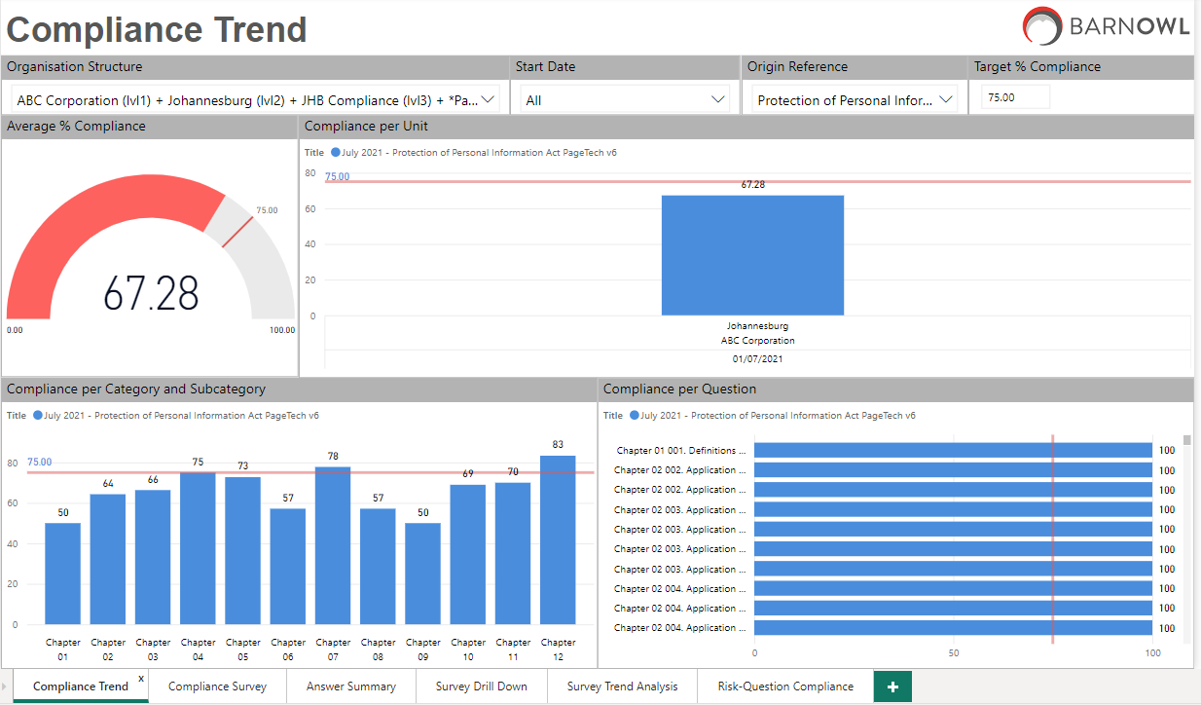
Standard Power BI Survey dashboard

Slide 22
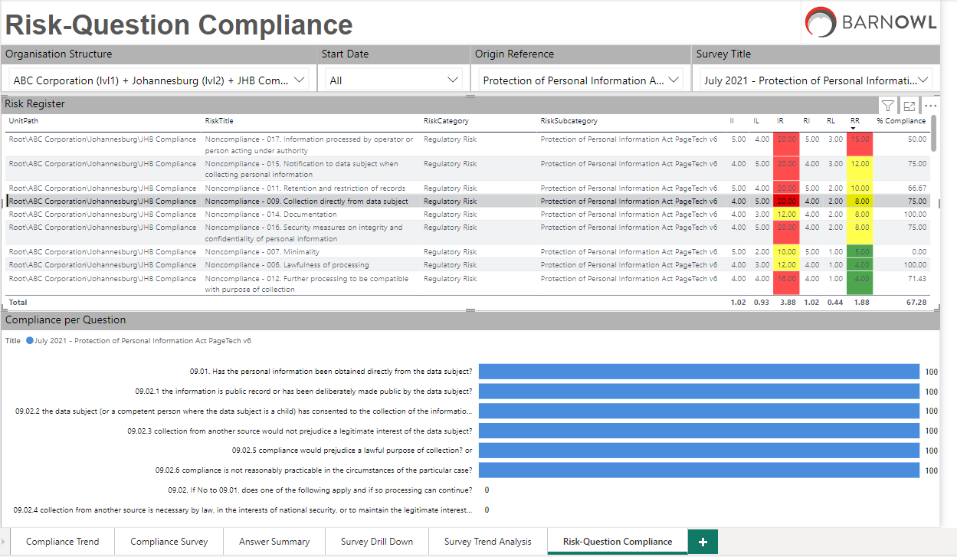
Standard Power BI Compliance CRMP dashboard

Slide 23
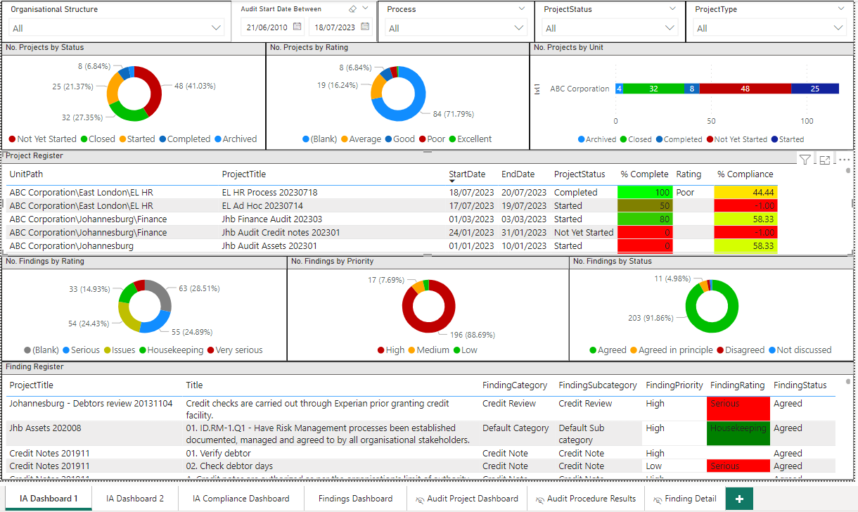
Standard Power BI Audit dashboard - Projects

Slide 24
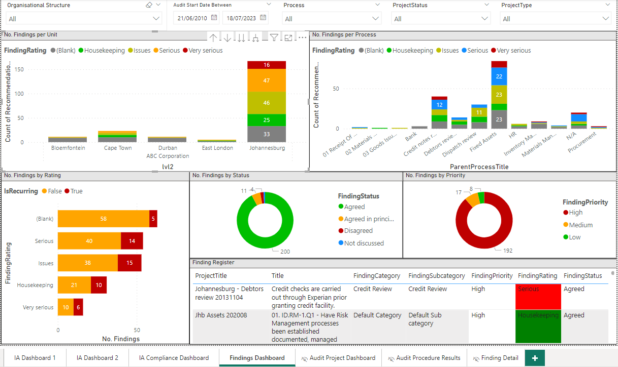
Standard Power BI Audit dashboard - Findings

Slide 25
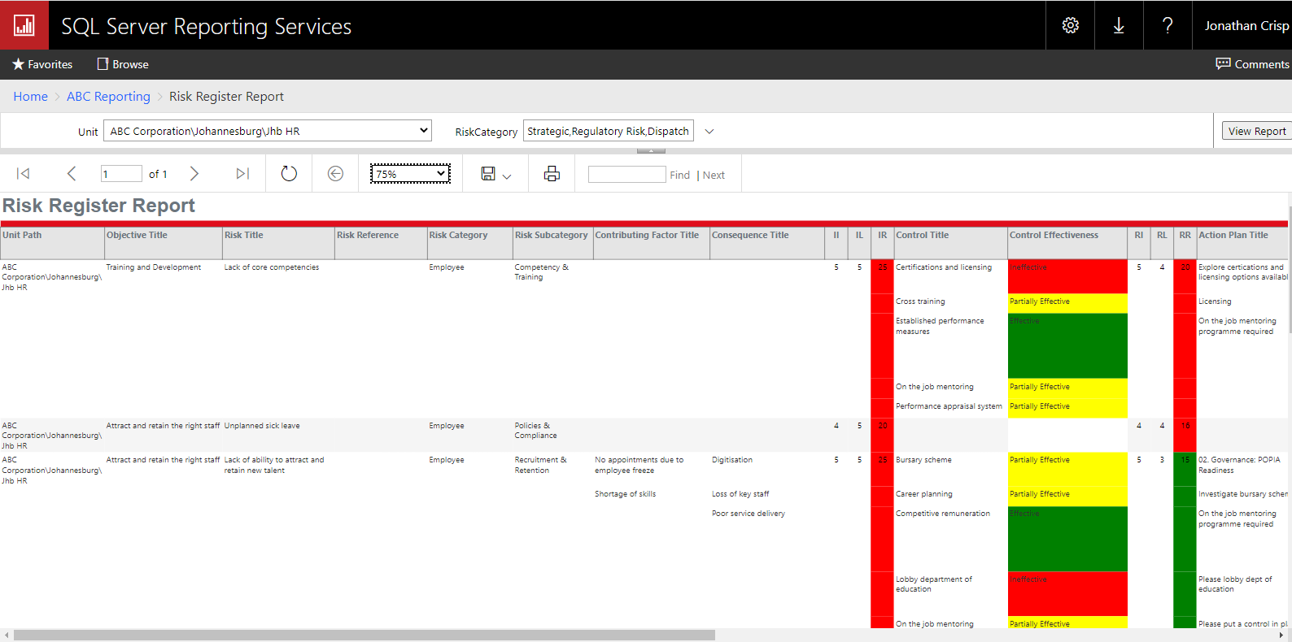
Standard SSRS Risk report

Slide 26
How do I upgrade to V11?
  New versions of BarnOwl contain not only the latest new features, but also performance enhancements and fixes. https://barnowl.co.za/knowledge-base/tip-of-the-month/frequently-asked-questions-about-upgrading-barnowl/
  The upgrade process is fully automated with a wizard-driven approach enabling Clients to upgrade themselves. This enables the Client to plan the timing of their Upgrade taking into consideration your IT approval processes, your change management process (i.e. communicating the impact of the new version to your users) and booking BarnOwl training where required:
  Step 1: Download the ‘Whats New’ document to view what changes have been made to this version. The What’s new document includes links to the relevant topic in BarnOwl’s online help
  Step 2: Download BarnOwl’s minimum System Requirements document and confirm with your IT, that your IT environment conforms to the technical requirements. For example .net framework 4.8 is required for version 11
  Step 3: Download the Guides from the ‘Client Hub>Support Hub Login, Knowledge Base’ or request a copy from BarnOwl Support.

Slide 27
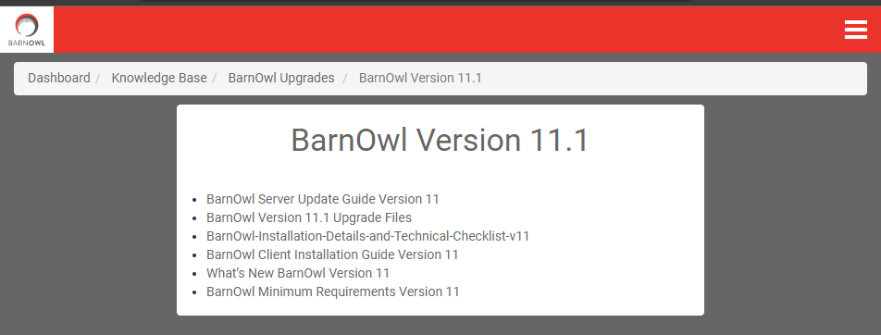
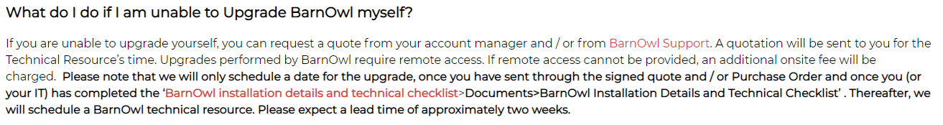
How do I upgrade to V11 (Continued)
  Step 4: Ask your IT to download the Upgrade files and follow the Update Guides: Client Hub>Support Hub Login, Knowledge Base:
Make full backups of all the databases which will be upgraded. This includes Production and UAT/Training databases.
Ideally a UAT environment should be upgraded, tested and signed off by the Client BarnOwl champion before the Production environment is upgraded.
Warn your users that BarnOwl will not be available for the duration of the upgrade. It is important that users don’t attempt to log in to BarnOwl while you are upgrading the version.

Slide 28
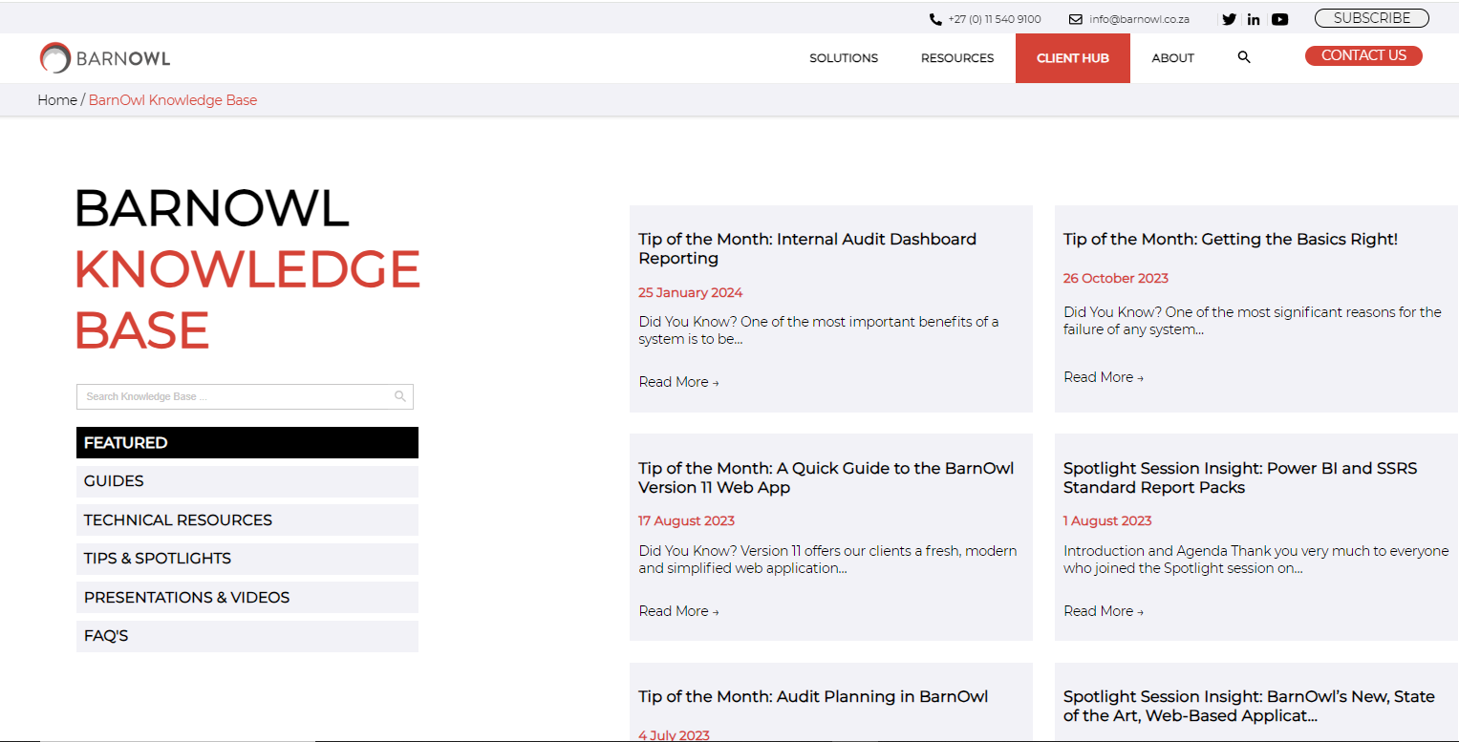
BarnOwl website: www.barnowl.co.za
https://barnowl.co.za/barnowl-knowledge-base/
https://barnowl.co.za/knowledge-base/knowledge-base-featured-main/spotlight-barnowls-new-state-of-the-art-web-based-application-v11/ Click here for recording
https://barnowl.co.za/knowledge-base/spotlight/barnowl-spotlight-session-power-bi-and-ssrs-standard-report-packs/ Click here for recording

Slide 29
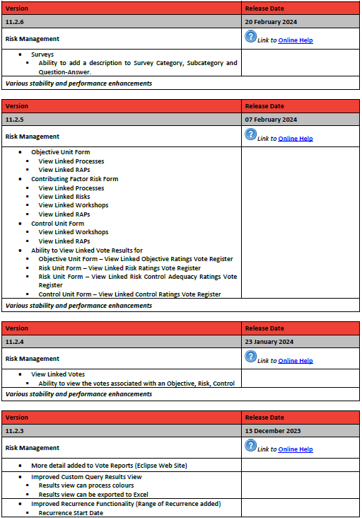
What's new document
https://barnowl.co.za/wp-content/uploads/2023/05/Whats-New-in-BarnOwl-v11.pdf

Slide 30
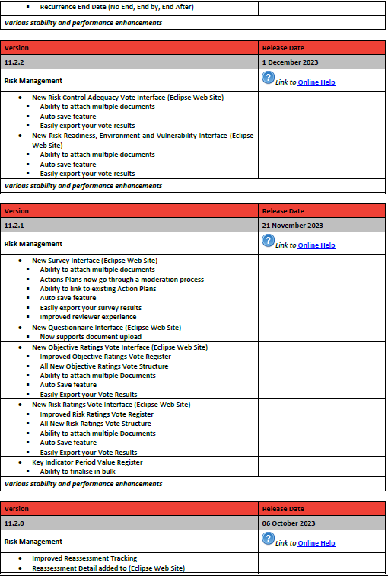
What's new document
https://barnowl.co.za/wp-content/uploads/2023/05/Whats-New-in-BarnOwl-v11.pdf

Slide 31
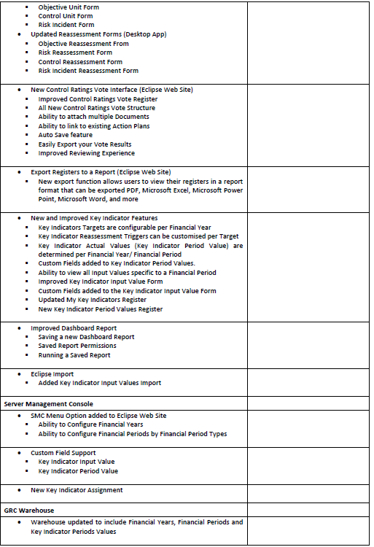
What's new document
https://barnowl.co.za/wp-content/uploads/2023/05/Whats-New-in-BarnOwl-v11.pdf

Slide 32
Conclusion
  Modern look & feel: easy and familiar to use
  Easy navigation: embed risk management
  Risk on a page: manage your risks in a simple and structured way
  Performance: great performance over WAN / VPN
  Enhanced functionality: Surveys, Questionnaires, Voting (RCSAs), KIs, custom field documents, action plan linked object, search visible fields etc.
  State of the art web-based technology: take advantage of leading edge technology
  In summary: v11.2 provides a far superior and simplified user interface enabling you to embed risk management more effectively within your organisation. In addition, real-time, BarnOwl Power BI and SSRS reporting enables you to consolidate, analyse and gain insights from your GRC universe at the click of a button.

Slide 33
Thank You
+27 11 540 9100 (office)
support@barnowl.co.za
+27 11 540 9112 (help desk)
https://barnowl.co.za/barnowl-knowledge-base/

